Slide 1
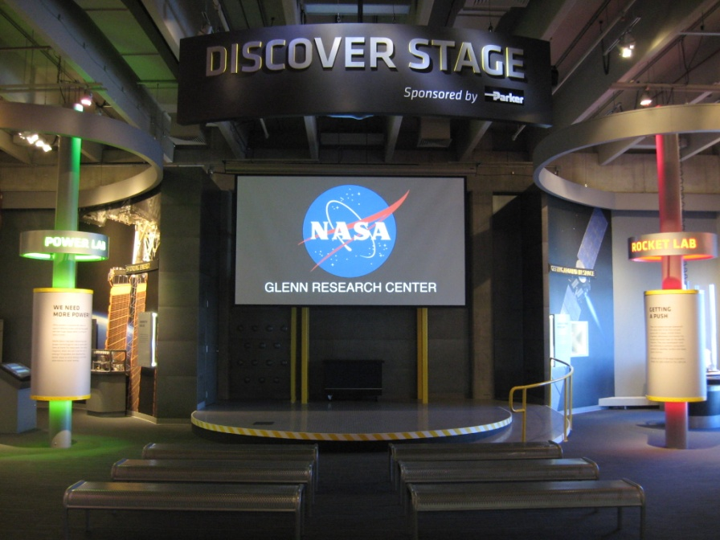

“Exhibits Technology Design that Works"
A Workshop for 2014 SEPA
By: Jeff Bowen
© ℗ 2014 Bowen Technovation, USA
Abstract: Modern design for a compelling exhibit can easily include reliable, cost-effective (yet engaging) audio, video and interactive capabilities. Jeff will provide an easy-to-understand, well-organized approach to determining what technology you might want to integrate into your next visitor experiences.
Case studies include :
NASA John Glenn Visitor Center
Computer History Museum
Others
Cost effective design, equipment, content and programming are all discussed in various levels of detail.

Slide 2





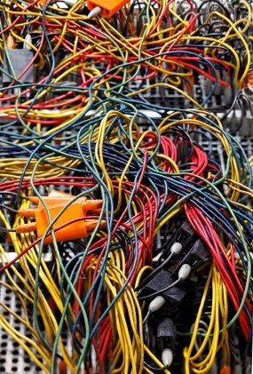
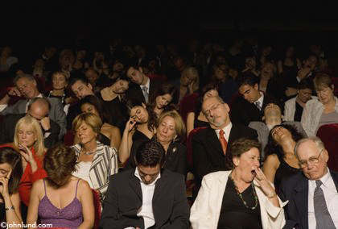
The Modern Exhibit
Digital
Easy
Cost effective
Reliable
Engaging
Fun
Interactive
Flexible

Slide 3
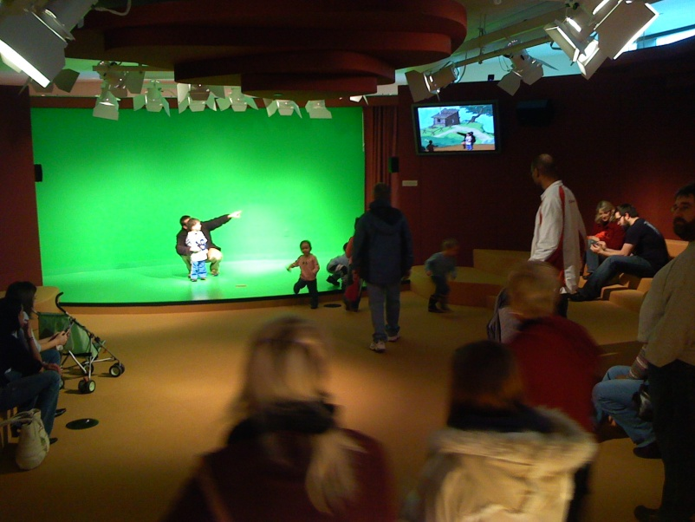
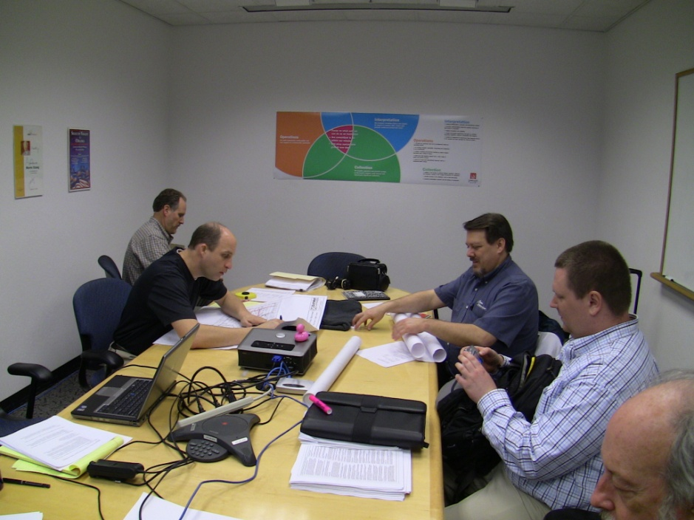
What We Will Explore
Simplest, lowest cost exhibits
Extremely complex projects
Visitor input
Making life easy…control systems
Audio and video distance limitations
Enhancing reliability
But First…
Some caveats and news…

Slide 4
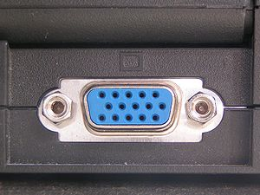
VGA Obsoletion
Intel and AMD have come to an agreement to
phase out computer VGA connections beginning in 2013 and expect the technology to be off all their product lines by 2015.
It will be replaced by HDMI and DisplayPort.

Slide 5
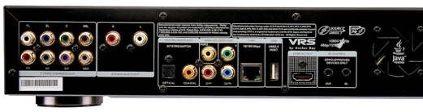
Analog Sunset
All BluRay players (and many new computers) have utilities burned into their chipset that will automatically turn off (or downscale to super low res) the component, composite, VGA and S-video outputs on December 31, 2013.
This is a Federal law that all manufacturers must adhere to.
That means they will only output HDMI or another digital format.

Slide 6
The Tool Box
Audio …mono…stereo…5.1/7.1…more
  Processor…amplifiers…speakers
Video …computer…media player…HDTV
  Extender…single display (touchscreen, flat panel, projector)
  Processor…
  Display…single screen…projector…multiple screens blended projection…videowalls
  Control
    Visitor input…scheduled…looping
    Docent/presenter override
    Special events
    Lighting
      Control…atmospheric…theatrical…motorized

Slide 7
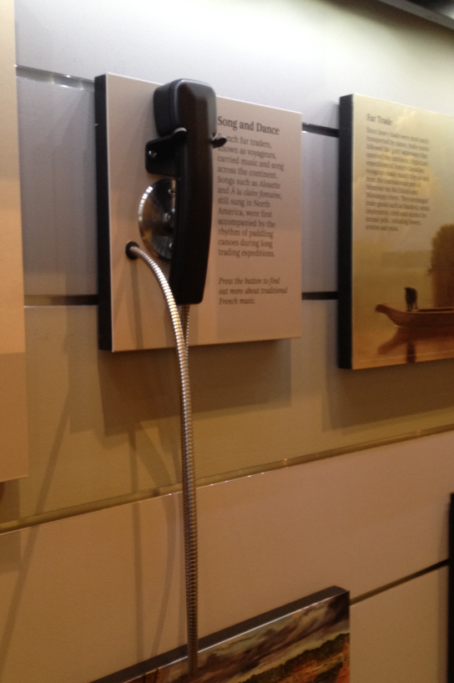

How Basic Can We go?
Looping Audio Only Player
Pros
  Plays audio
  Low cost
  Easy to maintain
  Easy to use
  Easy to update content
Cons
  Runs all the time, drives staff crazy
  No automated turn on-off?
  No visitor input or activation
  Wear and tear on equipment
Audio Source

Slide 8
The Next Step…Add Video/Graphics
Looping Video/Media Player
Pros
  Plays video, stills, audio
  Low cost
  Easy to maintain
  Easy to use
  Easy to update content
Cons
  Runs all the time, drives staff crazy
  No automated turn on-off?
  No visitor input or activation
  Wear and tear on equipment
Video Source
Video Display

Slide 9

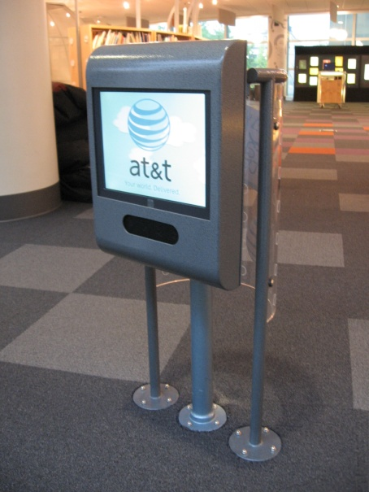
The Next Step… Visitor Input
Looping Video w Visitor Input
Pros
  Plays video, stills, audio
  Can add attract loop/graphic
  Low cost
  Easy to maintain
  Easy to use
  Saves wear and tear on equipment
  Keep galleries quiet when not in use
  Easy to update content
Cons
  No automated turn on-off
Video Source
Video Display

Slide 10

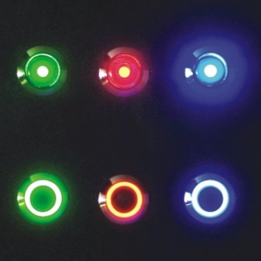
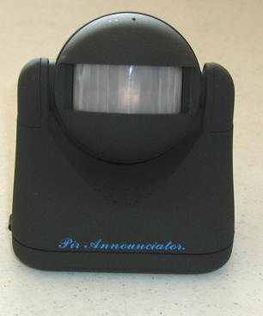

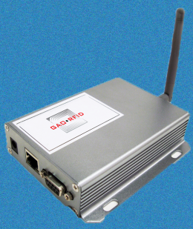
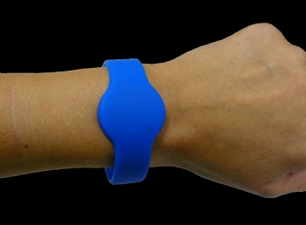
The Next Step… Visitor Input Types
Manual Button
Motion/proximity sensor
Touchscreen
RFID

Slide 11

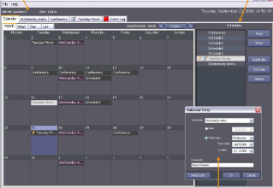
Introducing Basic Single Exhibit (Local) Automation
Smart Media Player w Visitor Input
  Has built in scheduler
Pros
  Adds daily turn-on off
  Plays video, stills, audio
  Low cost
  Easy to maintain
  Easy to use
  No wireway required
  Saves wear and tear on equipment
  Keep galleries quiet when not in use
  Easy to update content
Cons
  Manage exhibits one at a time…not global
Video Source
Video Display

Slide 12
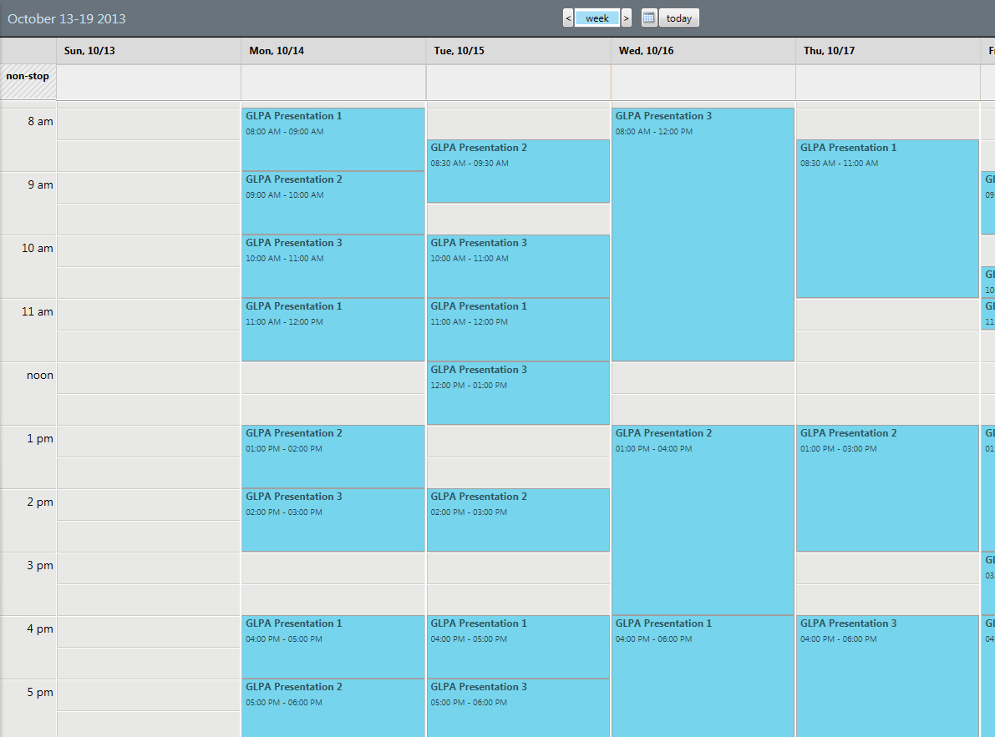
Introducing Basic Single Exhibit Automation

Slide 13
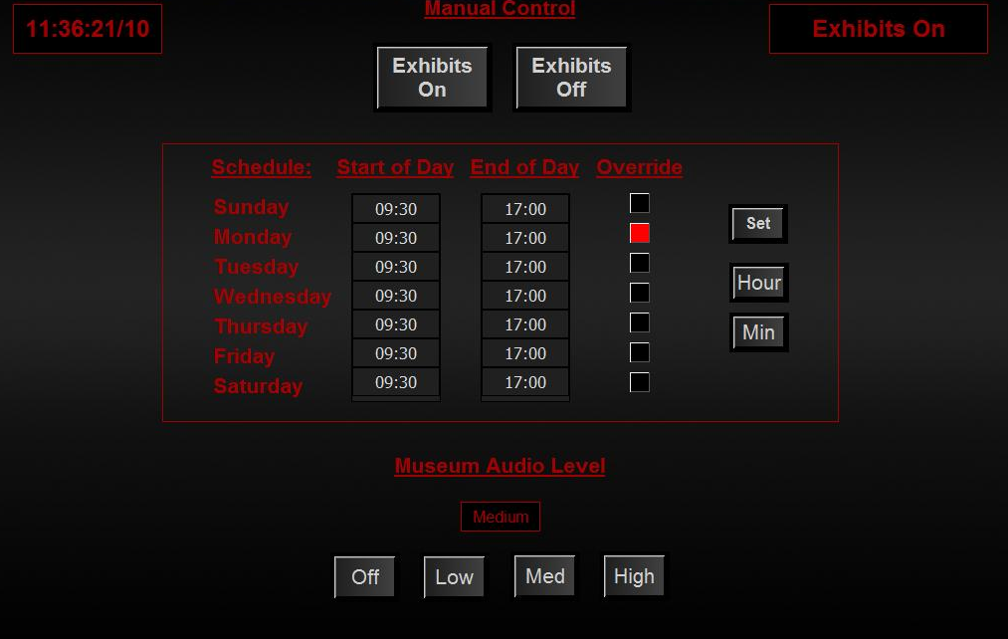
Multi-Exhibit Master Control/Automation
Pros
  Adds daily turn-on off for all exhibits
  Adds manual override for special events
  Adds docent overrides for live presentations
  Can send error notifications.
  Can track visitor usage (?)
  Can accept, process and monitor a variety of input devices
  Can control audio levels globally depending on visitor load
Cons
  Can be more costly
  Requires wireway/connectivity

Slide 14

Multi-Exhibit Master Control/Automation
Motion Sensor
Master Control System
with
Scheduler
Video Display
Video Source
Push Button
Interactive Computer
Touchscreen Display
Push Button
Robotics
Motion Sensor
Audio Player
Docent Override Switch
Projector
Video Source
iPad or Mobile Device

Slide 15
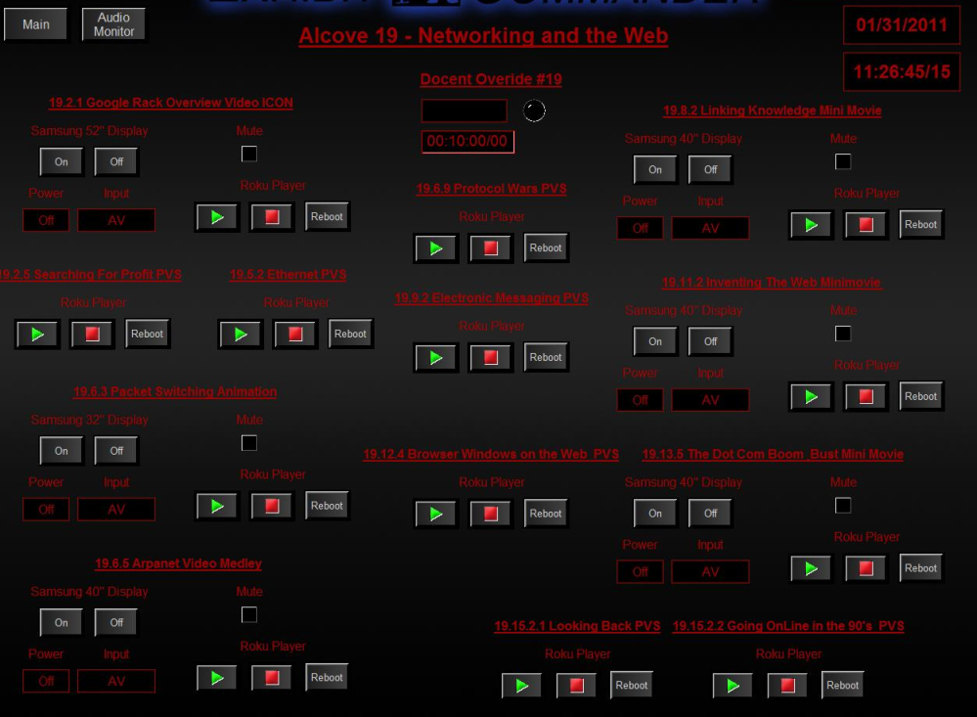
Multi-Exhibit Master Control/Automation

Slide 16
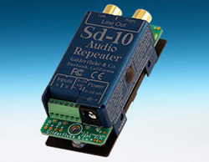
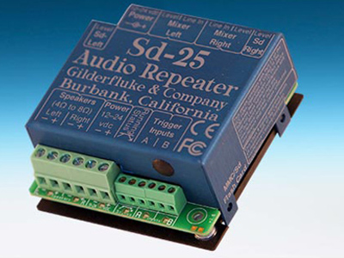
Tools: Simple Audio
Message Repeater/Players
Message Repeater/Players with Amp

Slide 17
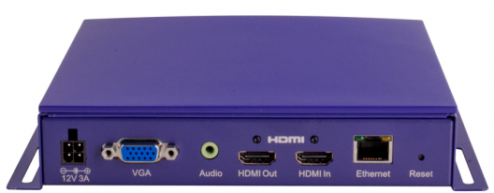
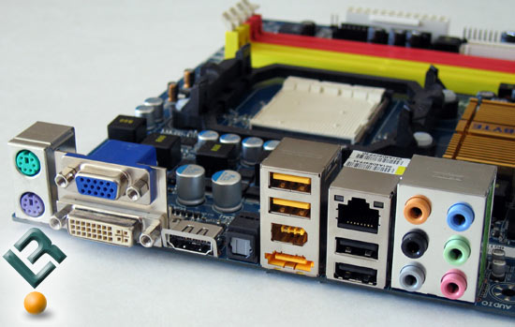

Digging Deeper…The Tools: Simple Video…One Screen
Media Players
  Perfect for true HD linear video
  Looping video
  Single display
Computers
  Use when a high degree of interactivity is needed
  Database type exhibits
  Single display
HDTV
  Use when streaming remote nature cameras, NASA, Discovery Channel, Nat’l Geo, World Cup, etc.

Slide 18
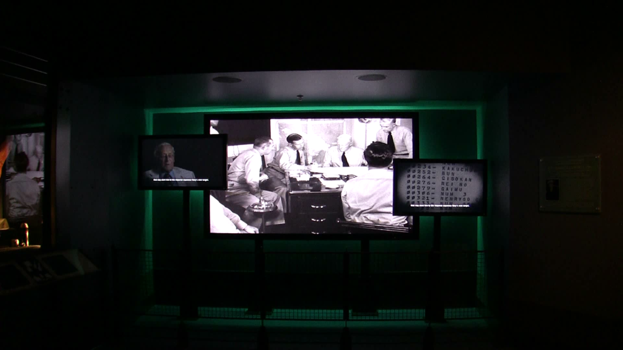
Digging Deeper…The Tools: More Complex Video
Single Displays
  Perfect for true HD linear video
  Looping video
  Single display
Blended Projector Displays
  Use when a high degree of interactivity is needed
  Database type exhibits
  Single display
Videowalls
  Use when streaming remote nature cameras, NASA, Discovery Channel, Nat’l Geo, U of I basketball, etc.

Slide 19
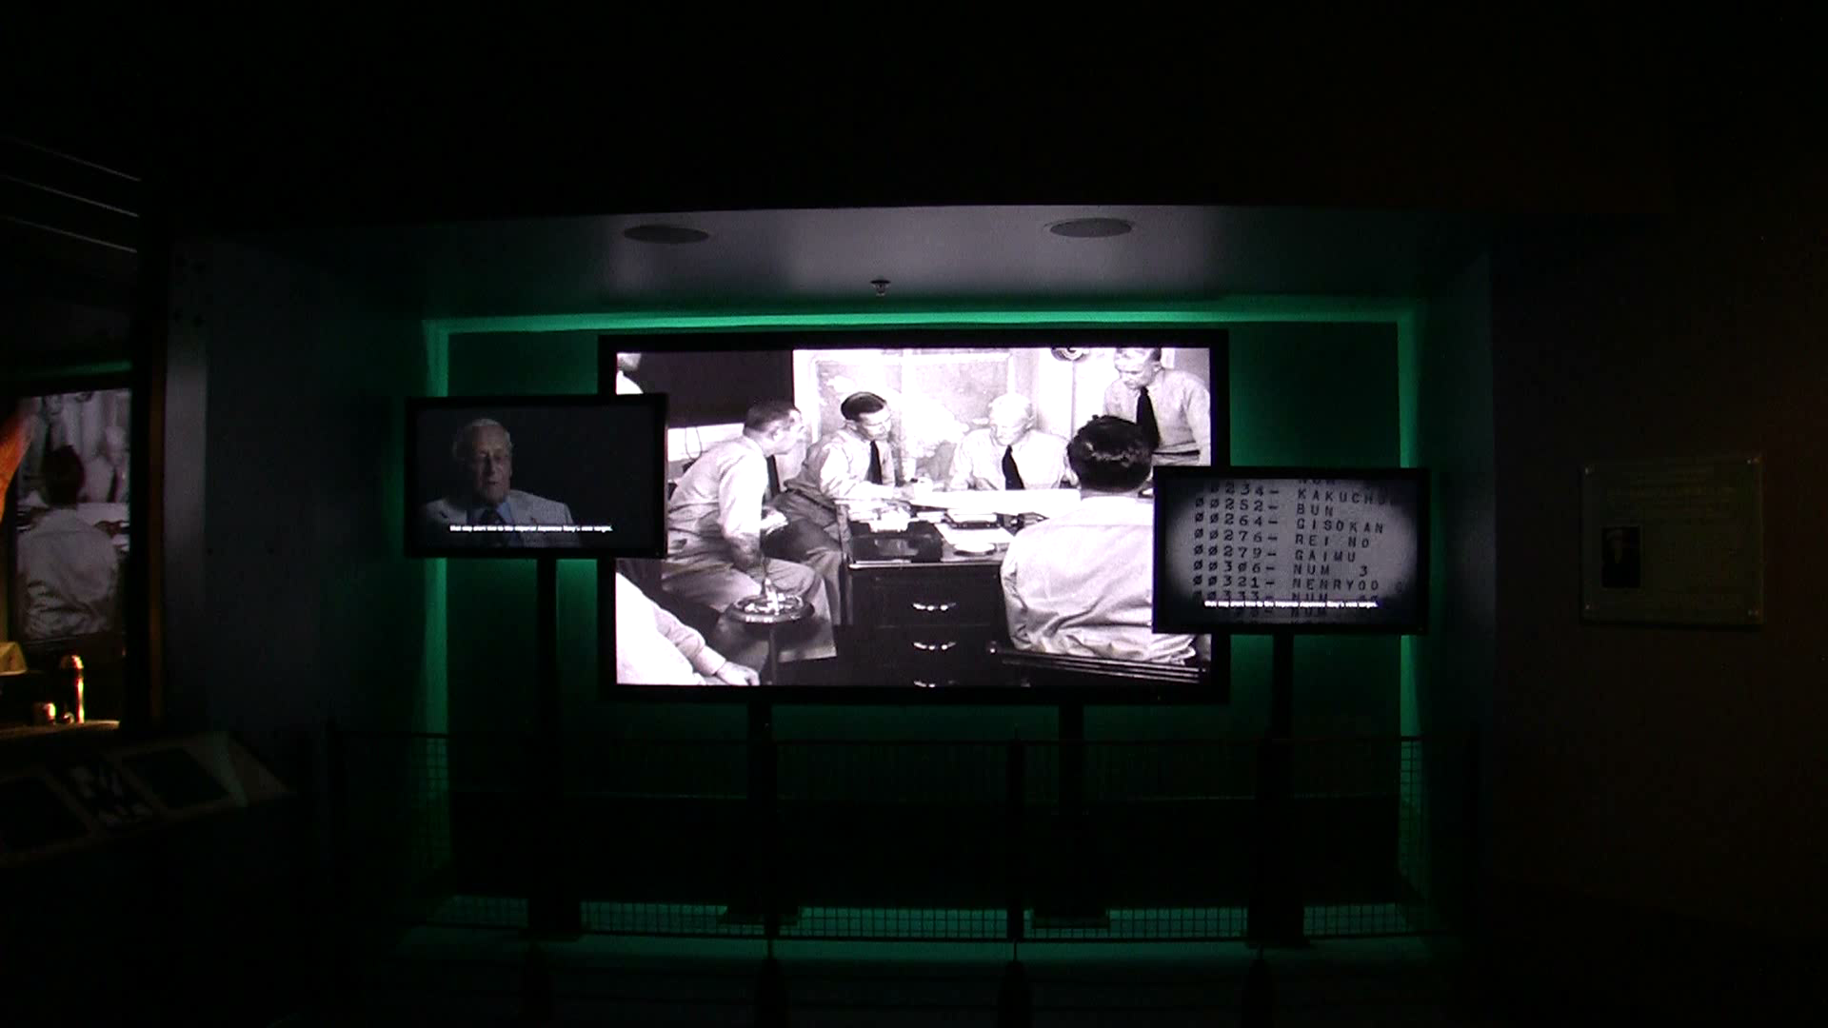
Digging Deeper…The Tools: More Complex Video

Slide 20
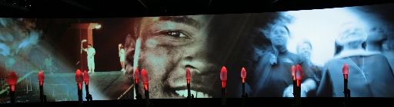
Digging Deeper…The Tools: More Complex Video
60’
Five Projectors
Multiscreen: Blended Displays
  When you want it huge.
  When you want it higher-res than a single screen.

Slide 21
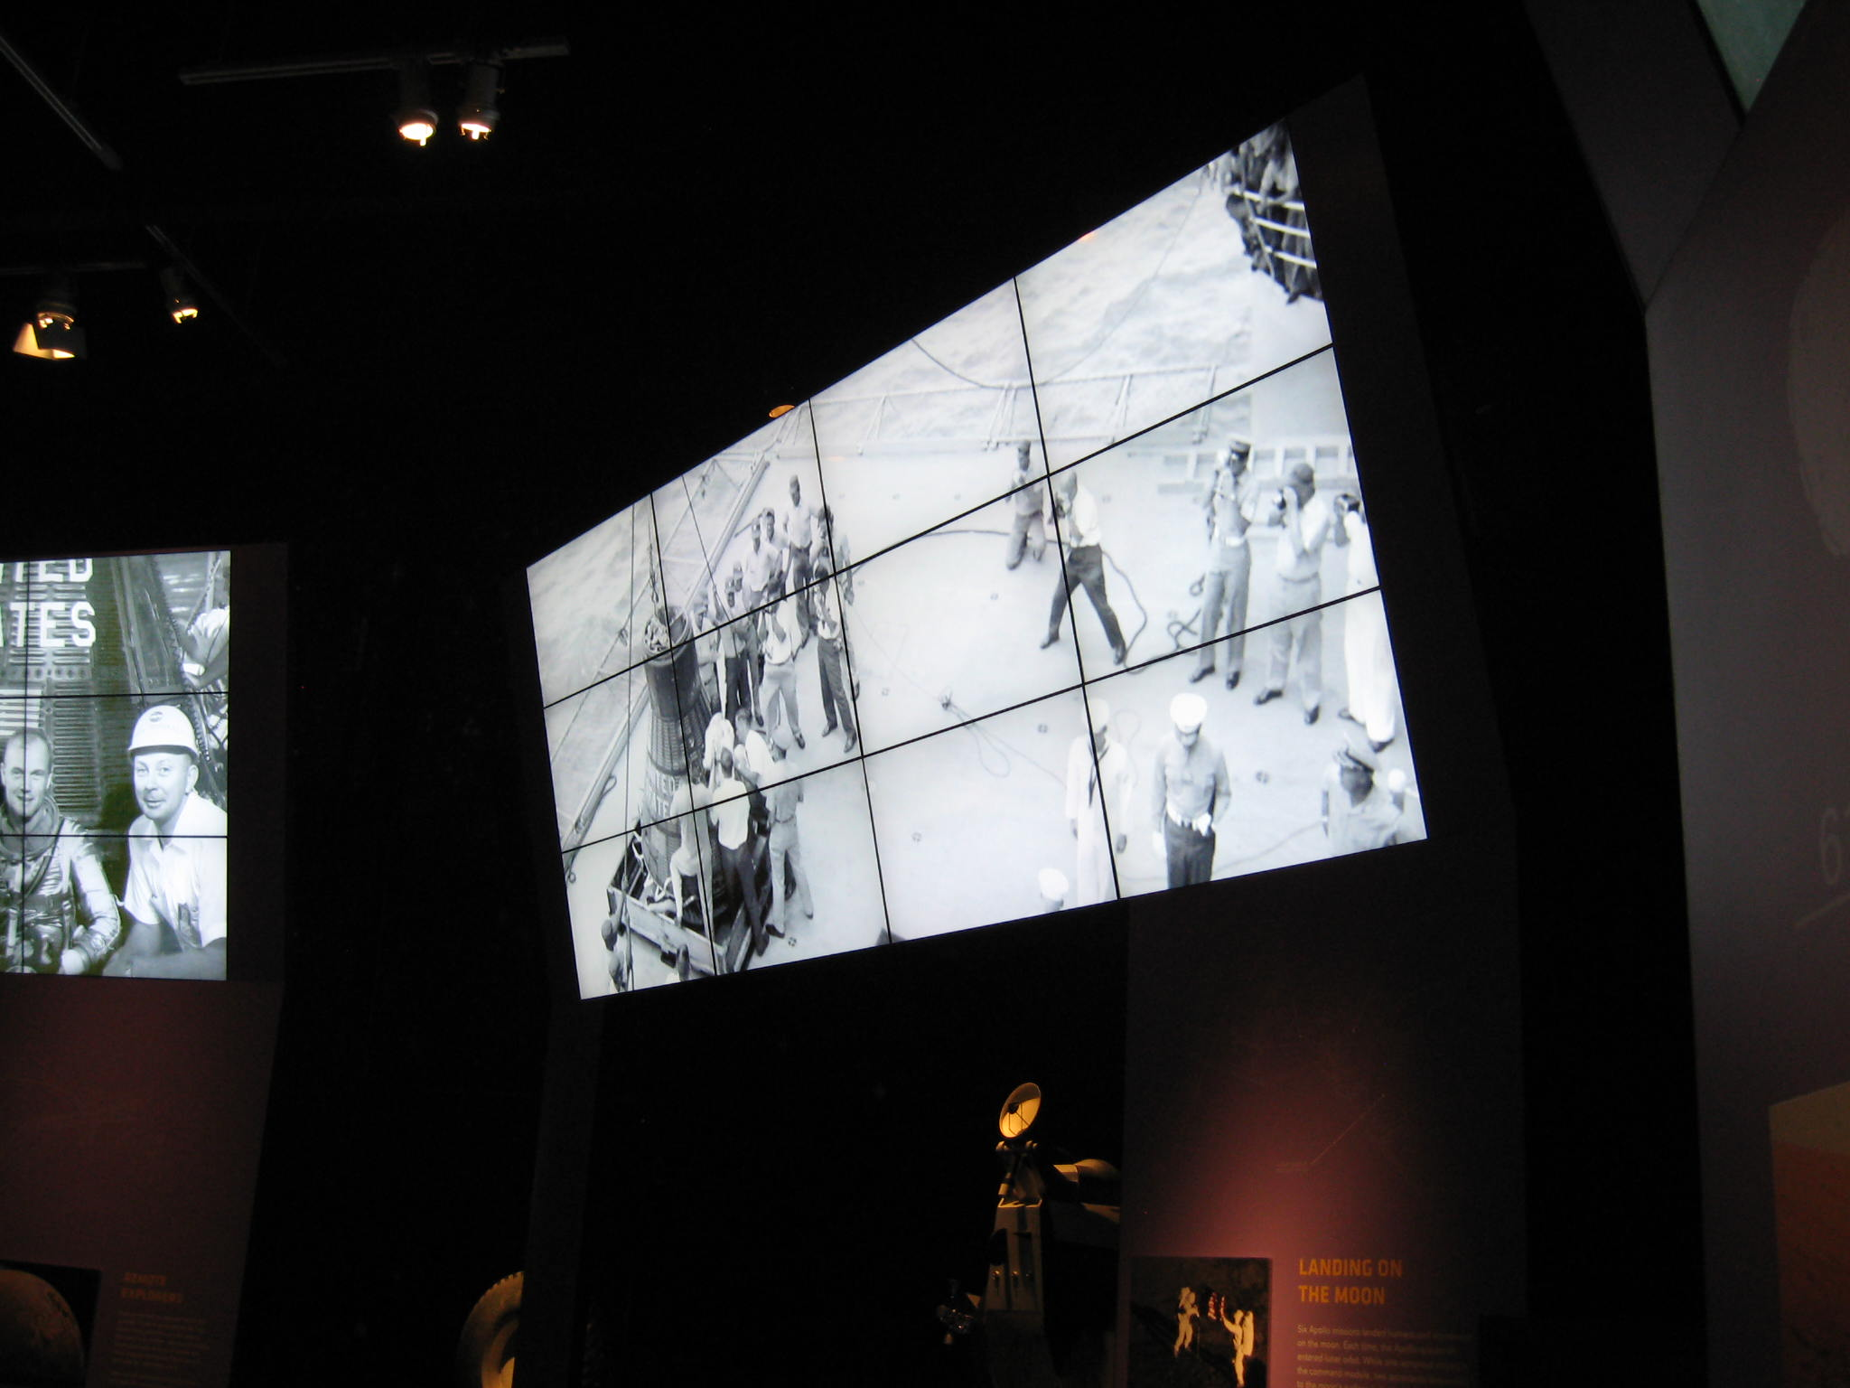
Digging Deeper…The Tools: More Complex Video
Multiscreen: Videowalls
  When you want it big and need to fight ambient lighting.

Slide 22
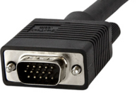
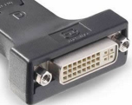
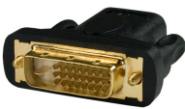
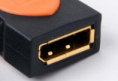
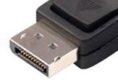
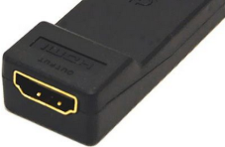
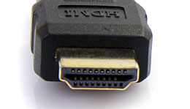
Digging Deeper…The Tools: Extenders…Distance Limitations:
Video Type | Future? | Distance Limitation (per official specification) | Female Connector | Male Connector | Audio
RGBHV (VGA) | Obsolete Now | 1.8 meters or 6-feet |  |  | Not on this cable. Run separate cable and connector.
DVI | Industry Plans Obsoletion of this ASAP. | 1.8 meters or 6-feet |  |  | Not on this cable. Run separate cable and connector.
Display Port | Not much signal chain support at this time | 15 meters or 49-feet |  |  | Stereo, 5.1, 7.1 audio supported on one cable and connector.
HDMI | The hottest ticket at this time. Tons of hardware available. | 9.1 meters or 30-feet |  |  | Stereo, 5.1, 7.1 audio supported on one cable and connector.

Slide 23
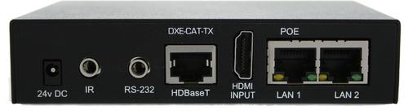
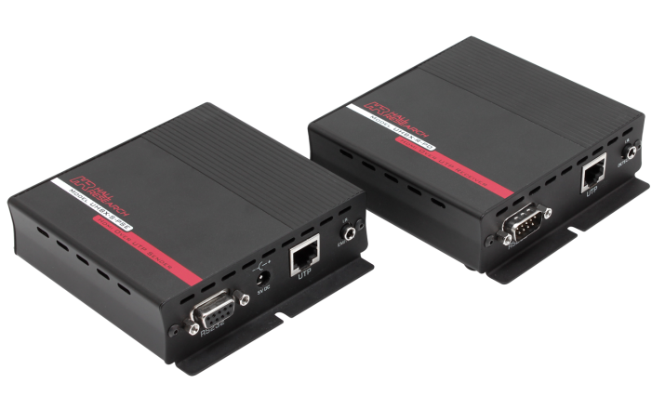
Digging Deeper…The Tools: Extenders…Distance Limitations: HDBaseT
Uses Single Cat 5/6 for 5Play™ feature set…
Full, uncompressed HD video to 4K and 3D
Audio
Ethernet
Power (100W)
And control (232, IR, other)
….over a single 100m cable.
EDID and HDCP capable

Slide 24
The Kitchen Sink!

Slide 25

“A Workshop for 2014 SEPA
of Planetariums - Lucerne
Digital
Easy
Cost effective
Reliable
Engaging
Fun
Interactive
Flexible

Slide 26
“Exhibits Technology Design that Works"
A Workshop for 2014 SEPA
http://www.bowentechnovation.com/resources/workshops/
Username: 1985
Password: bowen1985

