Slide 1
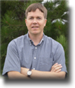
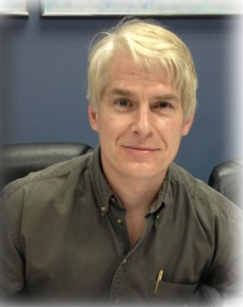
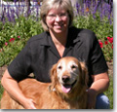
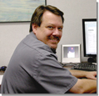
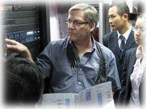
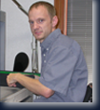
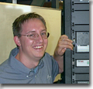
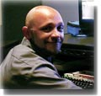
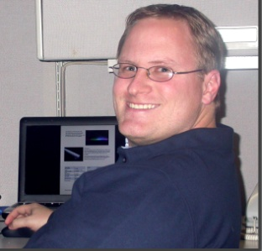
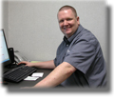
Bowen Technovation @ WAC 2014
“Bowen Technovation Celebrates 28 Years…Thanks!!!!!”
A few of our full time staff members

Slide 2
Hi jeff,
"I am really impressed by what Bowen Technovation could pull off even within short time notice - delivering and installing an excellent 7.1 Surround Sound System plus smooth RGB cove lights and spot lights in this high-end 3D-Fulldome-Theater. The slick touchscreen control of AstroFX with its open architecture is really easy to use, allowing to quickly monitor or adjust any light & sound atmosphere - and AstroFX is also listening directly to commands sent by the digital fulldome system (Digistar 5). It proved to be a really solid and stable system - even surviving several lightnings striking the theater with respective power-outages!"
Thomas W. Kraupe
Consultant and Director of Planetarium Hamburg (Germany), President of International Planetarium Society.

Slide 3
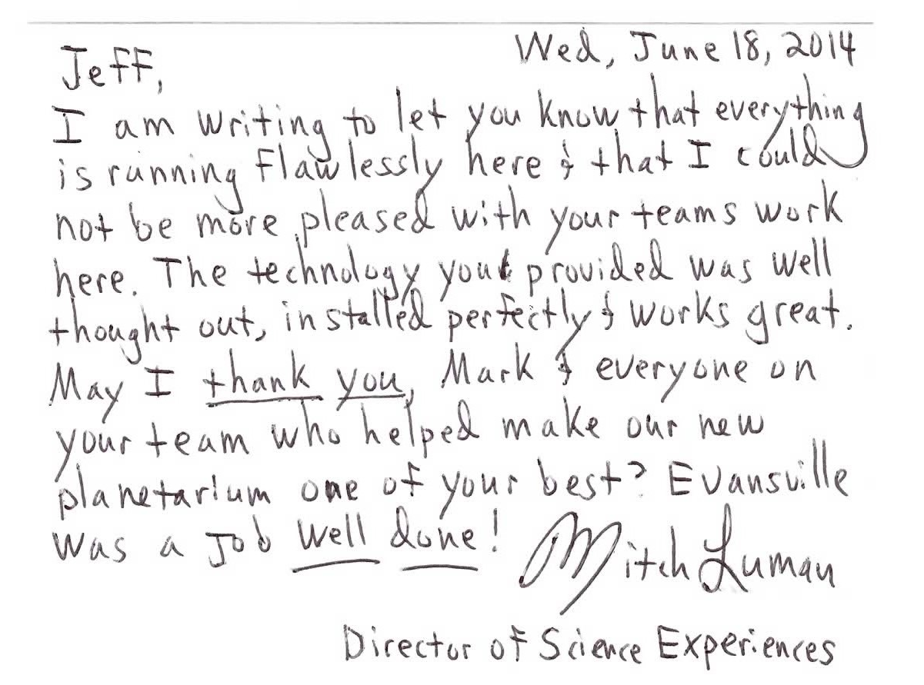
Hi jeff,
"I am really impressed by what Bowen Technovation could pull off even within short time notice - delivering and installing an excellent 7.1 Surround Sound System plus smooth RGB cove lights and spot lights in this high-end 3D-Fulldome-Theater. The slick touchscreen control of AstroFX with its open architecture is really easy to use, allowing to quickly monitor or adjust any light & sound atmosphere - and AstroFX is also listening directly to commands sent by the digital fulldome system (Digistar 5). It proved to be a really solid and stable system - even surviving several lightnings striking the theater with respective power-outages!"
Thomas W. Kraupe
Consultant and Director of Planetarium Hamburg (Germany), President of International Planetarium Society.

Slide 4
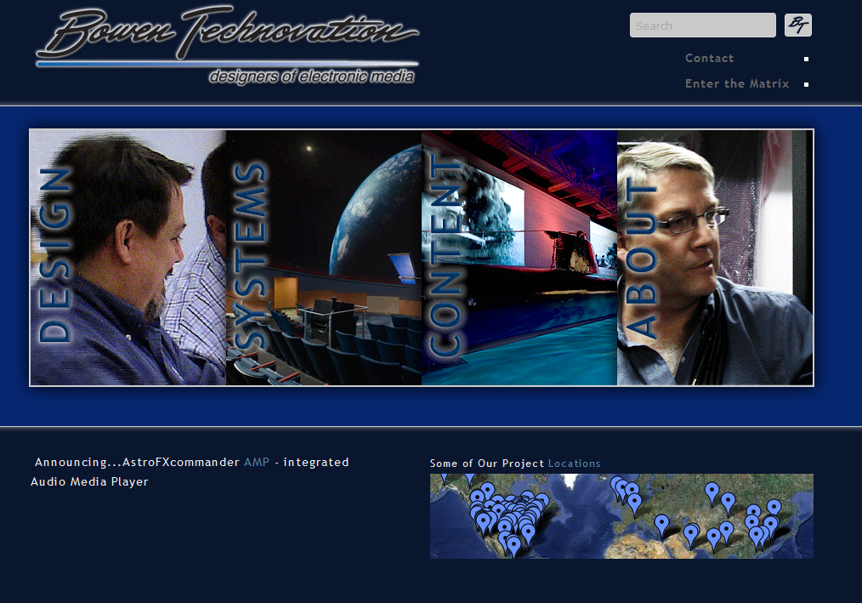
New Stuff from BT
Totally re-invented BT website.
Video tutorials.
Datasheets/info/specs.
System
comparison guides.
Workshops.
Show descriptions.
Design advice.

Slide 5
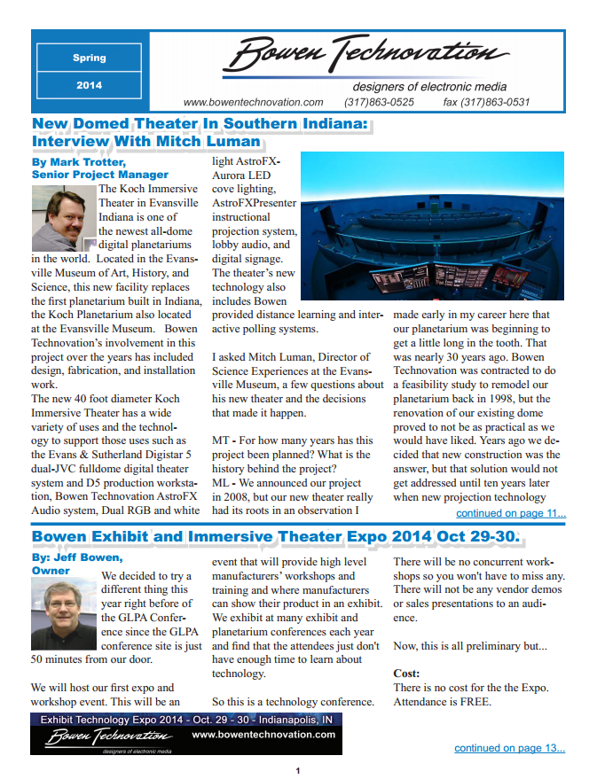
New Stuff from BT
June 2014 Newsletter
Available online.
1600 hard copies…2200 electronic sent.
Written by BT staff… not some ad agency.
Project descriptions.
New equipment and reviews for exhibits and theater.
Workshops/columns.

Slide 6
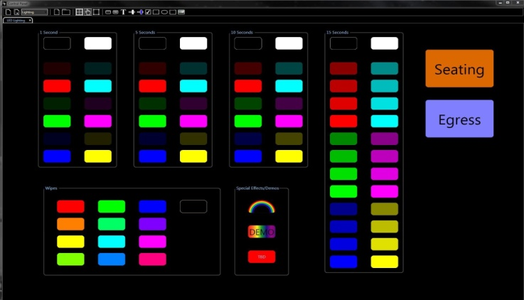
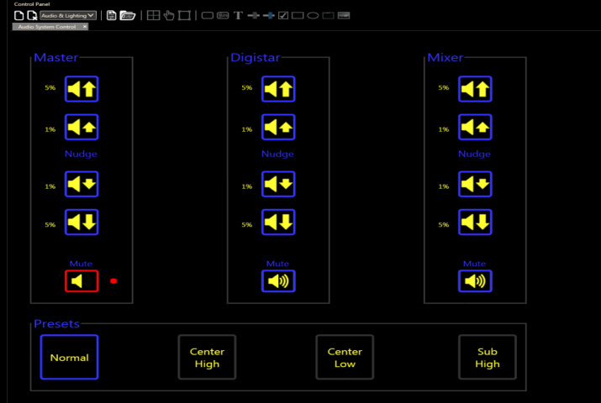
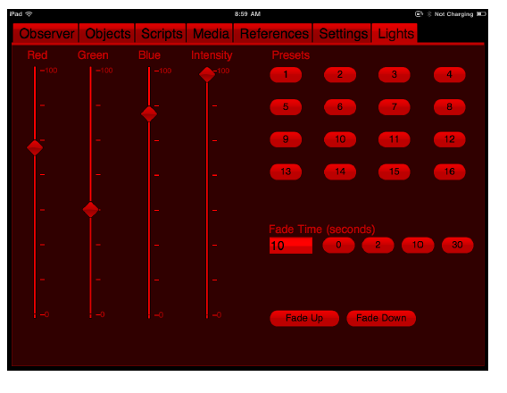
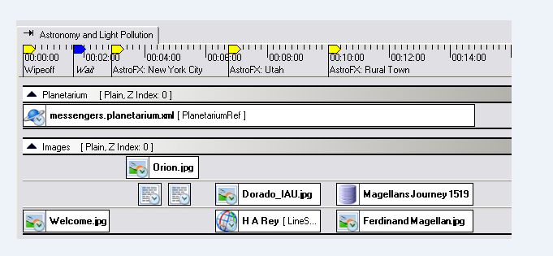
New Stuff from BT
New AstroFX control interfaces for:
E&S
Digitalis
SciDome
Zeiss
Minolta (underway).

Slide 7
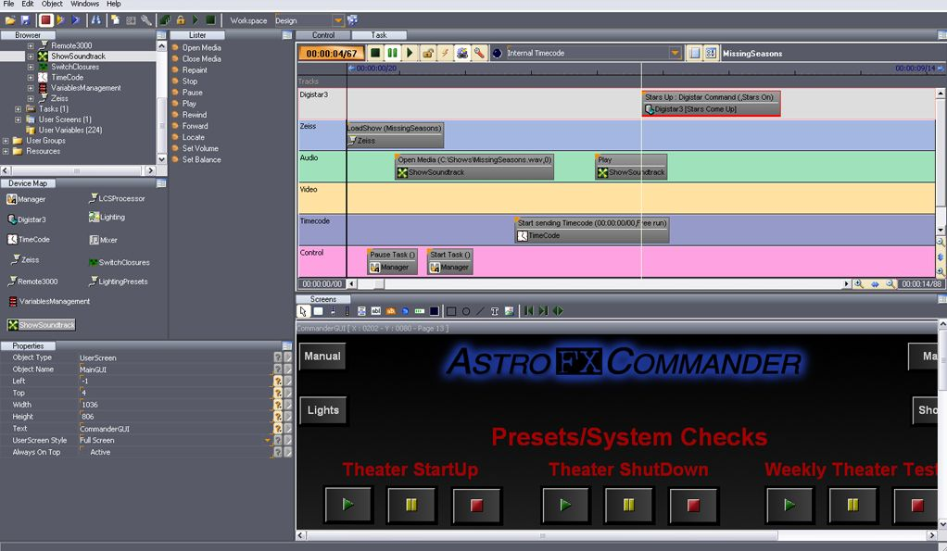
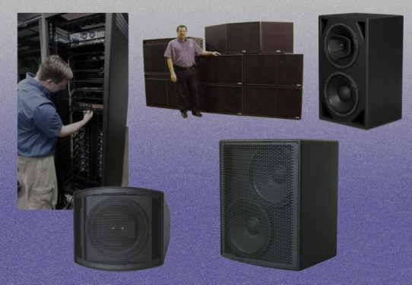
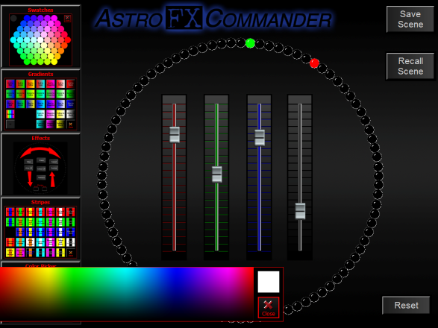
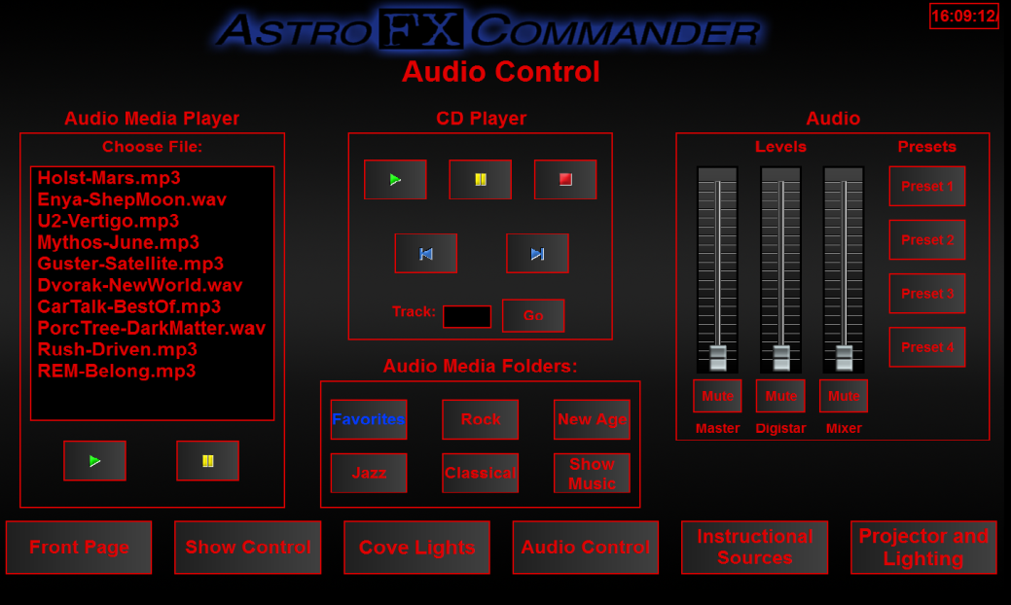
New Stuff from BT
New upgrade for FXCommander to V6 with iPad integration.
New speaker designs special for domes…no plastic!
New AstroFXAurora control screens.
New AstroFXCommander AMP built in audio media player.
New high power LED dimmable whites.
AstroFXAurora LightJamz!

Slide 8
The Objectives:
Educate architects, museum , science center, planetarium professionals how to create engaging exhibits.
Inspire those who do not have an immersive theater to build one.
Teach all the above how to better select and operate their equipment.

Slide 9
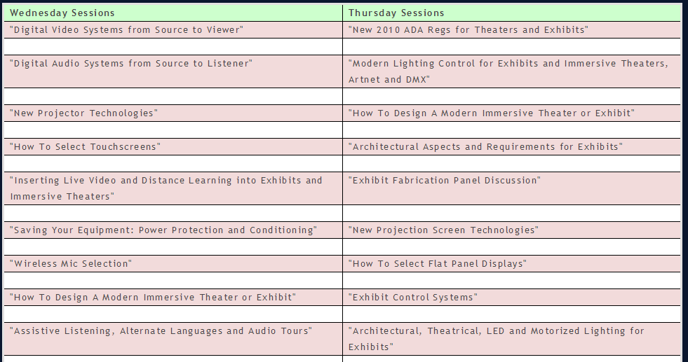

Slide 11
“Bowen Technovation Celebrates 28 Years…
Thanks!!!!!”
A few of our full time staff members

