Slide 1
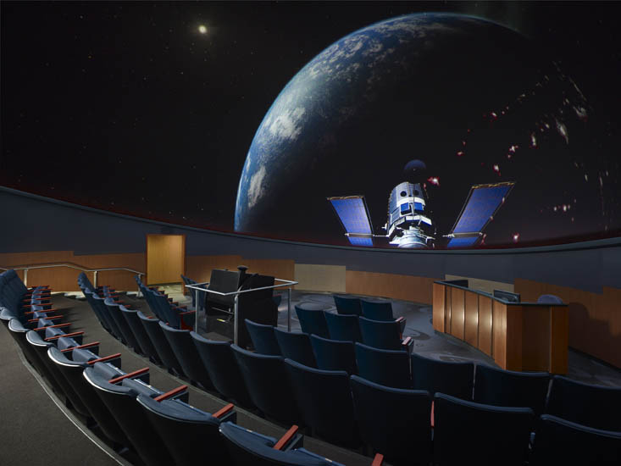
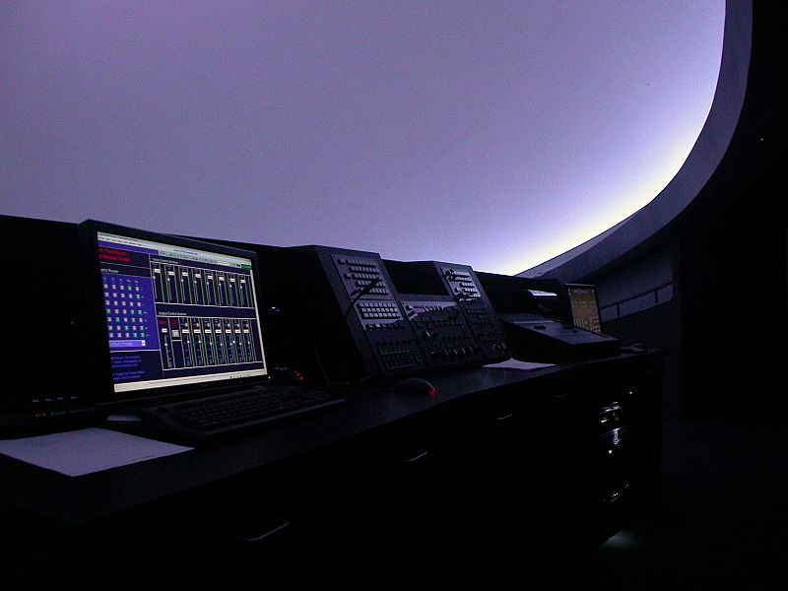
“Modern Instructional/Event Presentation Technologies for Immersive/Planetarium Theaters”
A Workshop for WAC 2014
By: Jeff Bowen
© ℗ 2014 Bowen Technovation, USA
Abstract: The modern design for a domed theater should include extensive audio-video-control capabilities for instruction, special events, and other multimedia uses. This package is one of the most overlooked parts of theater upgrade or new construction design.

Slide 2
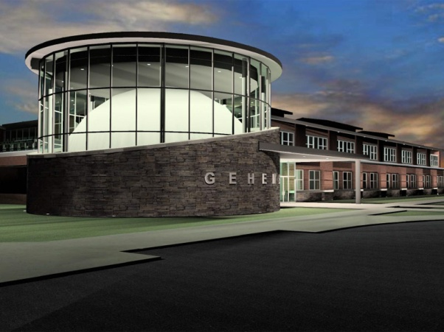
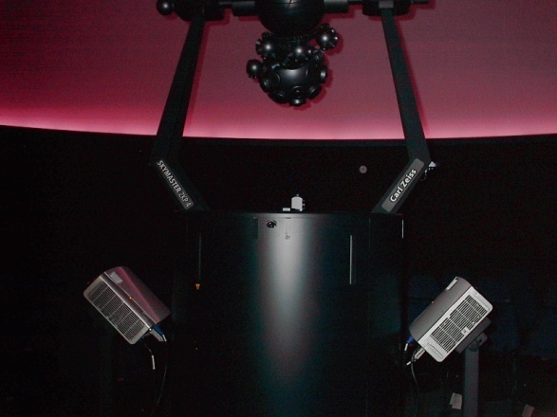
“Modern Instructional/Event Presentation Technologies for Immersive/Planetarium Theaters”
Why add such capabilities:
To all-dome video:
HDCP Compliancy!!!!
Brighter lumens per square foot.
Lose image and text legibility using all dome warping/blends.
Ease of use. Don’t turn on all-dome system.
Most do not provide hi-res external inputs
Wear and tear on projectors
Wear on matched lamps.
Fallback presentation system.
To optical projectors:
To add BluRay videos, PowerPoint, NASA select, educational programming.
To extract 5.1 surround sound from these.
To add compatibility with new digital computer outputs.
Equipment stays put and is ready for use.

Slide 3
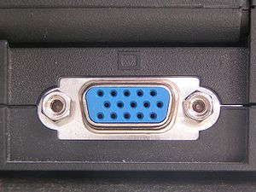
“Modern Instructional/Event Presentation Technologies for Immersive/Planetarium Theaters”
Special Considerations
VGA Obsoletion
Intel and AMD have come to an agreement to
phase out computer VGA connections beginning in 2013 and expect the technology to be off all their product lines by 2015. It will be replaced by HDMI and DisplayPort.

Slide 4
“Modern Instructional/Event Presentation Technologies for Immersive/Planetarium Theaters”
Special Considerations
Analog Sunset
All BluRay players have utilities burned into their chipset that will automatically turn off (or downscale to super low res) the component, composite, VGA and S-video outputs on December 31, 2013. This is a Federal law that all manufacturers must adhere to. That means they will only output HDMI or another digital format.

Slide 5
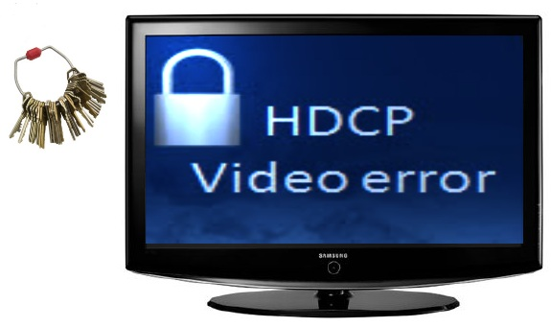
“Modern Instructional/Event Presentation Technologies for Immersive/Planetarium Theaters”
Special Considerations
High-bandwidth Digital Content Protection (HDCP ) Compliancy
Commonly though incorrectly referred to as High-Definition Copyright Protection, is a form of digital copy protection developed to prevent copying of digital audio and video content as it travels across connections.
Digital Rights Management (DRM)
Digital rights management (DRM) is a class of access control technologies that are used by hardware manufacturers, publishers, copyright holders and individuals with the intent to limit the use of digital content and devices.
Extended Display Identification Data (EDID)
Provided by a digital monitor or projector to describe its capabilities to a video source. It is what enables a modern computer, HDTV or Bluray to know what kinds of monitors are connected to it

Slide 6
Why not use your all-dome system for nuts & bolts instruction?
Lower resolution: 25 times the resolution is typical. See next slide
2. Wear and tear on expensive projectors and lamps.
HDCP , DRM and EDID Compliancy
Analog Sunset

Slide 7
Why not use your all-dome system for nuts & bolts instruction
1. Resolution: Pixels on the Dome 10’ wide image
All-dome HD Projector = 0.1M pixels on a 12’ wide image in 40 foot dome
= 1.1 K pixels per ft²
Dedicated HD Projector = 2.3M pixels on a 12’ wide image in 40 foot dome
= 25.5K pixels per ft²
20-25x resolution plus impact of light level
1920 x 1200 =2,304,000 pixels per projector
1,450,000 pixels visible per projector on dome for all-dome system
40 x 40 x 3.14/2 = 2512 ft² dome surface area or 1256 per ½ dome
1154 pixels per ft² pixels with all-dome projector
12’ w x 7.5’h image = 90 ft² dome = 2.3M pixels or 25.5K pixels per ft² dome with one dedicated projector.
12’ w x 7.5’h image = 90 ft² dome = 0.10M or 1.1K pixels per ft² dome with all dome projector
20-25 x resolution plus impact of light level

Slide 8
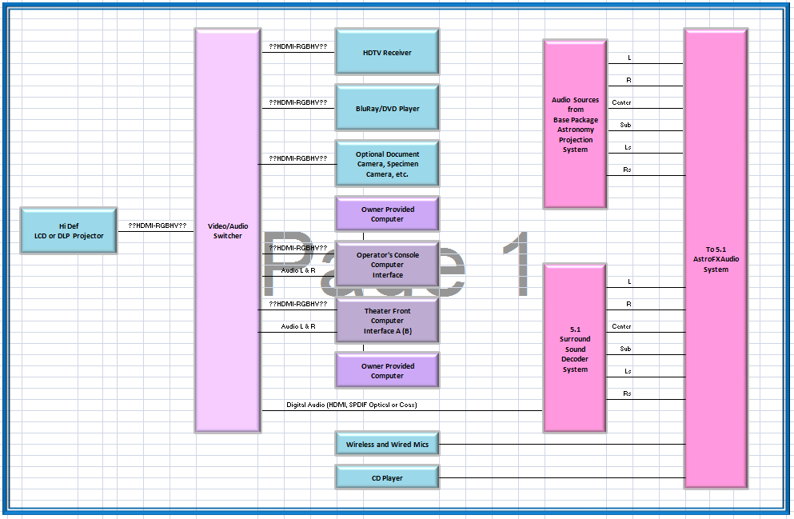
Basic Signal Path
To 5.1 Audio System

Slide 9
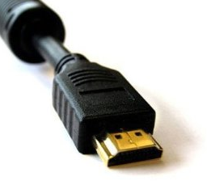
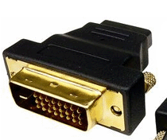
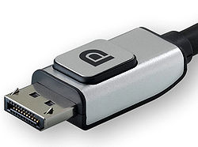
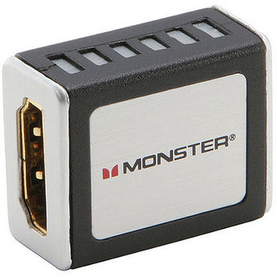
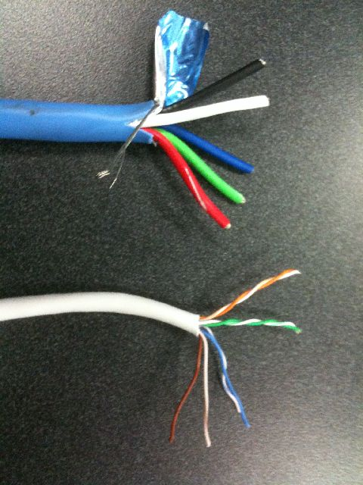
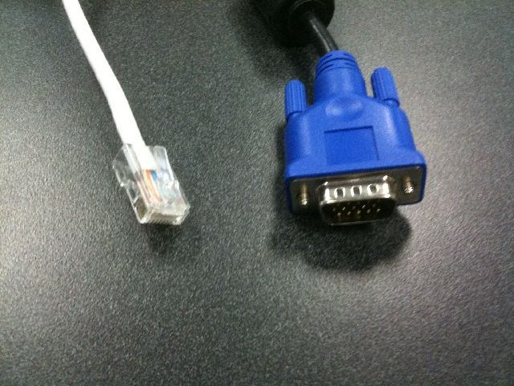
Future of Obsoleted RGBHV (VGA) and Futureproofing Video
RGBHV (VGA)
DVI
HDMI -M
DisplayPort
HDMI -F

Slide 10
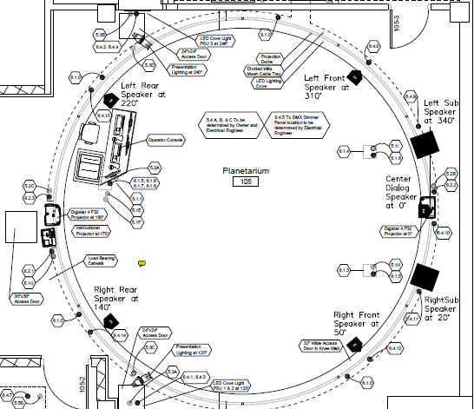
Where to locate computer and video inputs.
Computer/video/audio connection in floorbox under podium
Computer/video/audio connection in floorbox under podium
Computer/video/audio connection in pop up box at console.

Slide 11
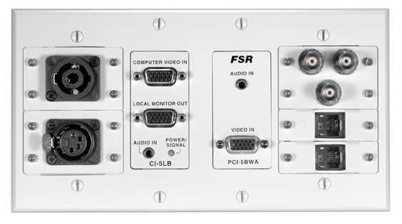
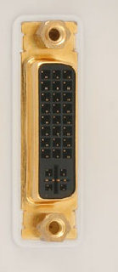
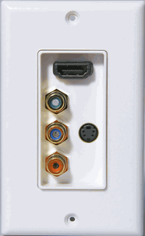
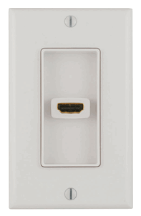
Connections
No DVI?
Why?

Slide 12
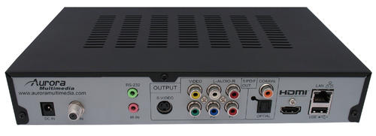
BluRay and HDTV tuners.
SPDIF digital audio out. Coax/toslink optical.
HDMI Out
Serial / Ethernet Control

Slide 13
Distance Limitations
6’
6’
30’
15m
30’
Digital deterioration due to distance
Corrected digital signal

Slide 14
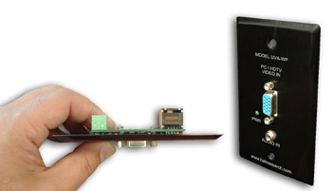
Distance Limitations: UTP-CAT5/6 Extenders (Unshielded Twisted Pair)
Extender CAT5
RGBHV (VGA)

Slide 15
Routing and Legacy RGBHV
4x1
HDMI. Audio???
RGBHV to HDMI Converter w Audio
Switcher/Scaler
HDMI, RGBHV
CV, YC (S). Audio???
4x1
HDMI w 7.1 Audio

Slide 16
Distance Limitations: HDBaseT
Uses Single Cat 6 for 5Play™ feature set…
Full, uncompressed HD video to 4K and 3D
Audio
Ethernet
Power (100W)
And control (232, IR, other)
….over a single 100m cable.
EDID and HDCP capable

Slide 17
Distance Learning/Conferencing
Sources to Projector
Live In-Dome Camera
Far End Camera (Webcam, etc)
Computer (PPT, etc)
BluRay
HDTV
Sources to Network
Live In- Dome Camera
Live Mics
Show Audio
Computer (PPT, etc)
BluRay
HDTV
Sources to Audio System
Presenter Mic
Audience Mic
Far End Audio
Show Audio
CD Audio
BluRay Audio

Slide 18
“Modern Instructional/Event Presentation Technologies for Immersive/Planetarium Theaters”
A Workshop for WAC 2014
By: Jeff Bowen
© ℗ 2014 Bowen Technovation, USA
http://www.bowentechnovation.com/resources/workshops/
1985 username
bowen1985 password

