Slide 1
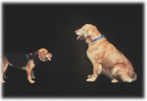
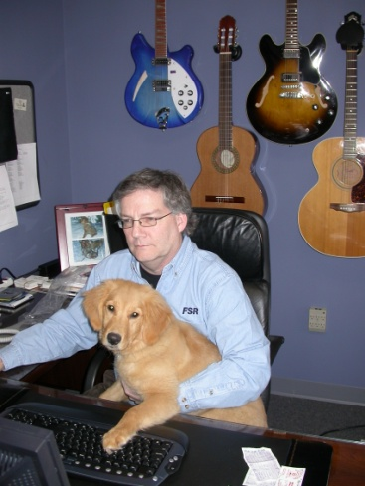
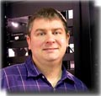
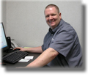
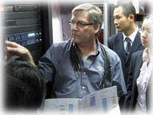
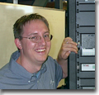
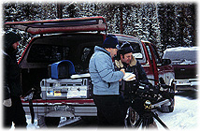
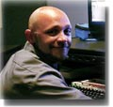
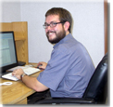
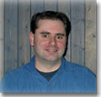
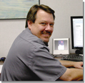
“Bowen Technovation Celebrates 25 Years…
Thanks!!!!!”

Slide 2
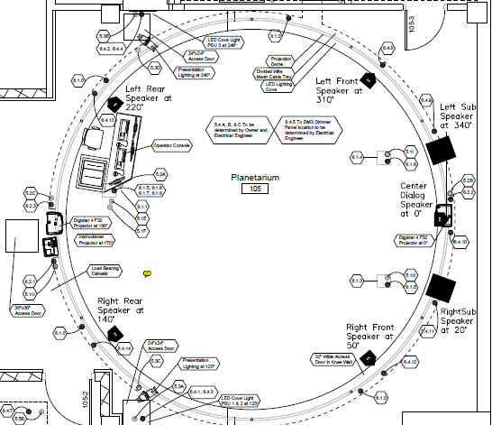
“Modern Instructional/Event Presentation Technologies for Immersive/Planetarium Theaters”
A Workshop for GLPA2011
By: Mike Grznar, Jeff Norris
© ℗ 2011 Bowen Technovation, USA
Computer/video/audio connection in floorbox under podium
Computer/video/audio connection in floorbox under podium
Computer/video/audio connection in pop up box at console.

Slide 3
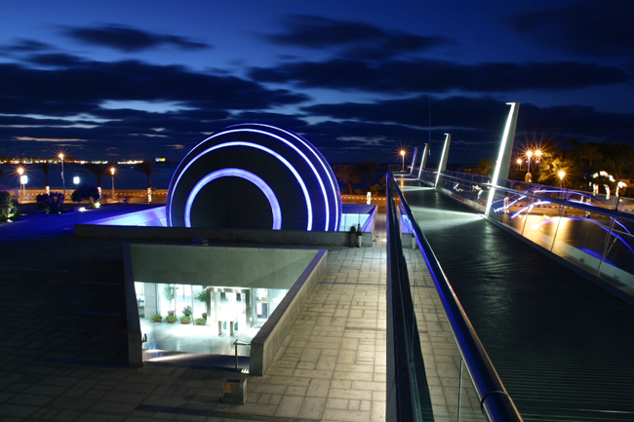
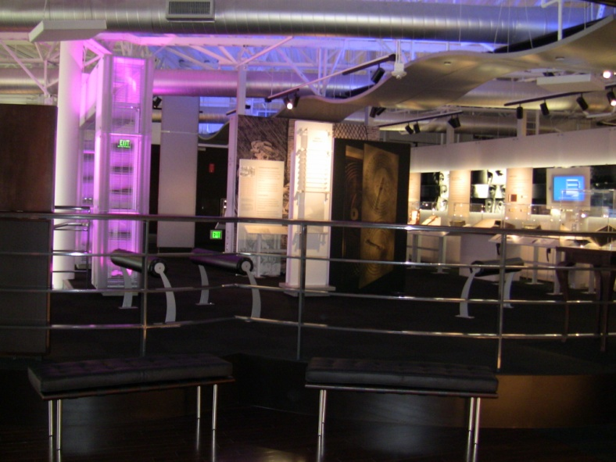
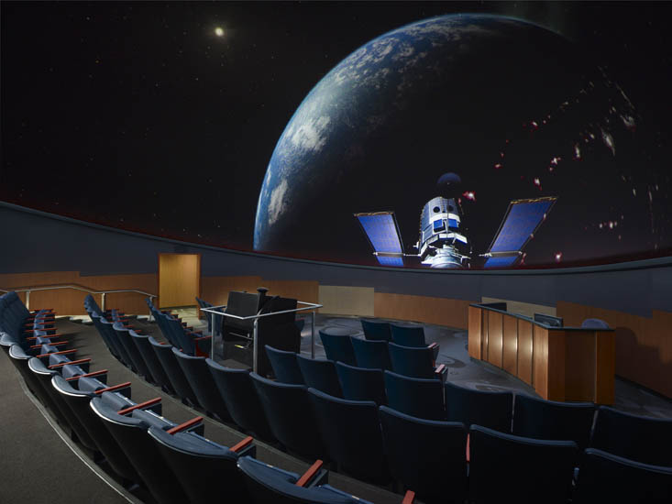
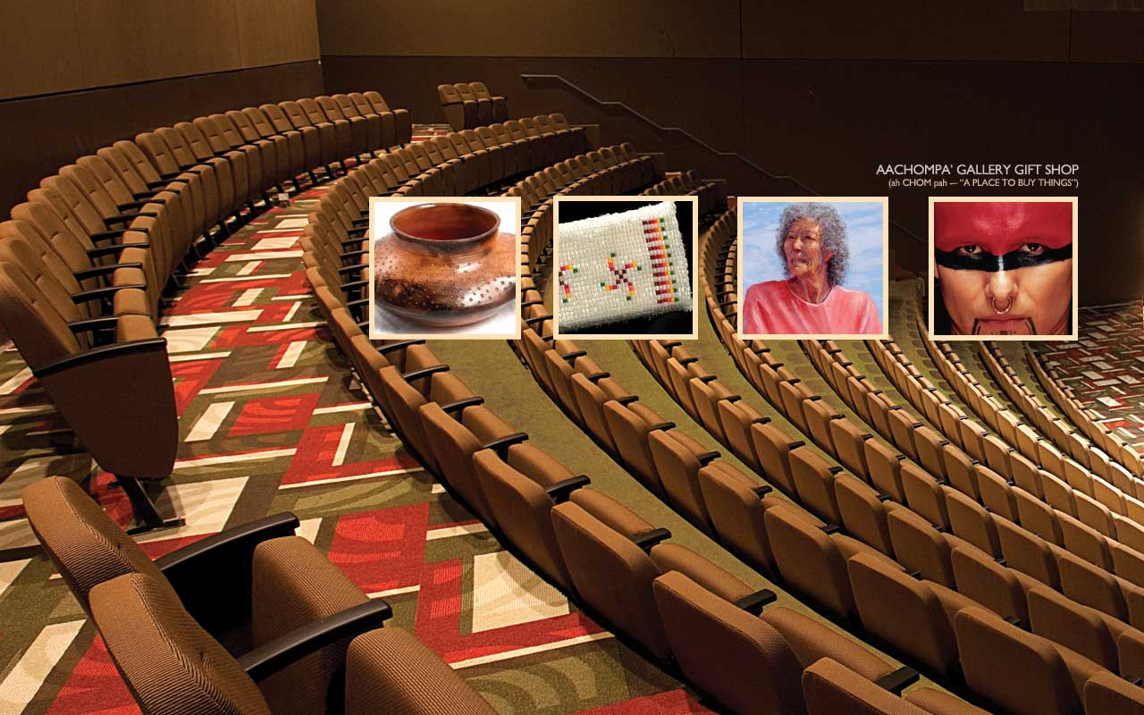
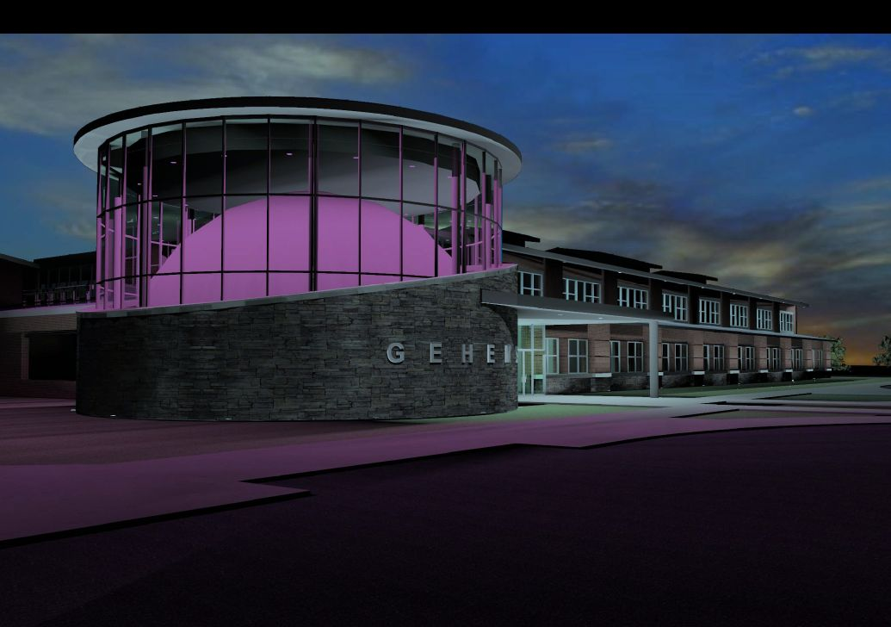
Interesting Recent Projects
P-H-M Planetarium Mishawaka, IN
Cranbrook Institute, MI
East Hartford Glastonbury, CT
Biblioteca, Alexandria, EG
CCSD Gillette Schools, WY
Missouri Western State University, MO
Valdosta Sate University, GA
Calgary Science Center
Computer History Museum, Silicon Valley
Palomar Planetarium, CA
Roberson Museum
Planetarium, NY

Slide 4
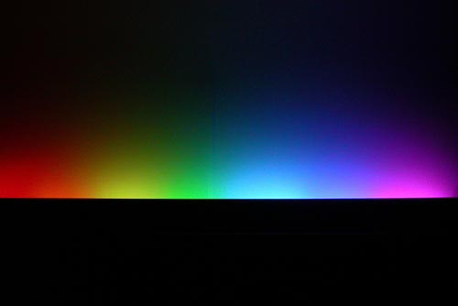
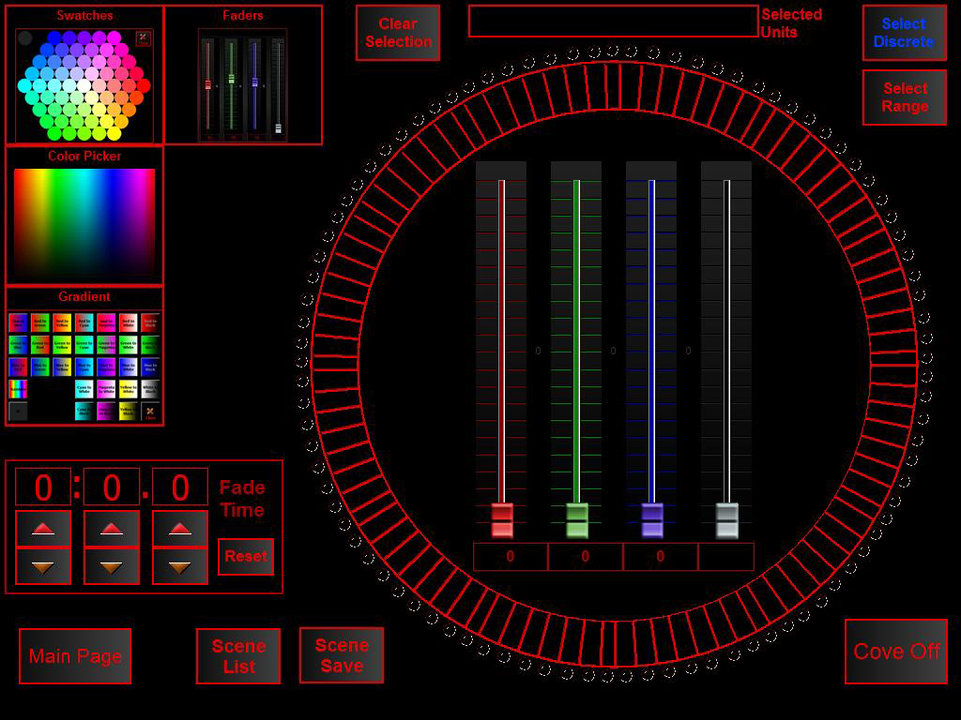
In Our Booth
New G4 LED Light Control GUI

Slide 5
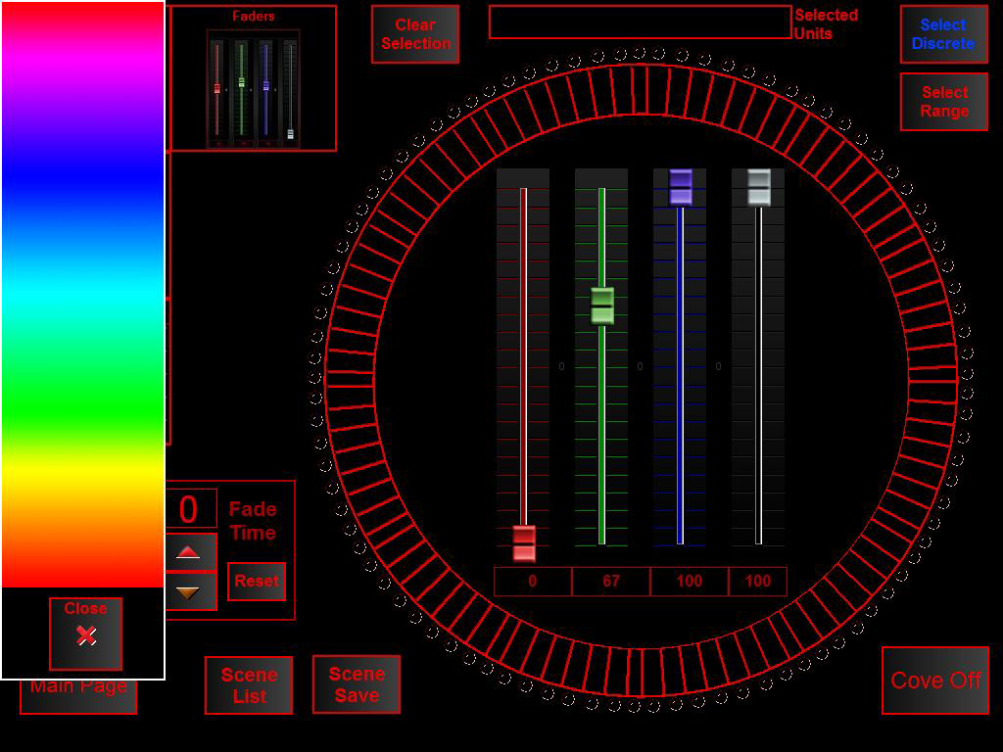
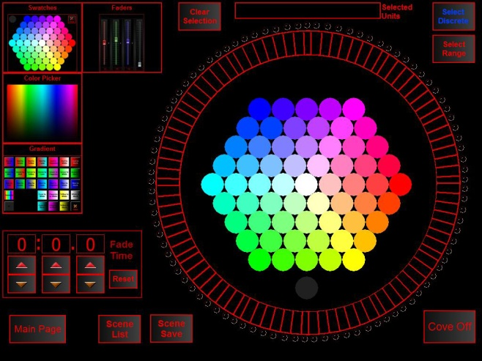
In Our Booth
New G4 LED Light Control GUI

Slide 6
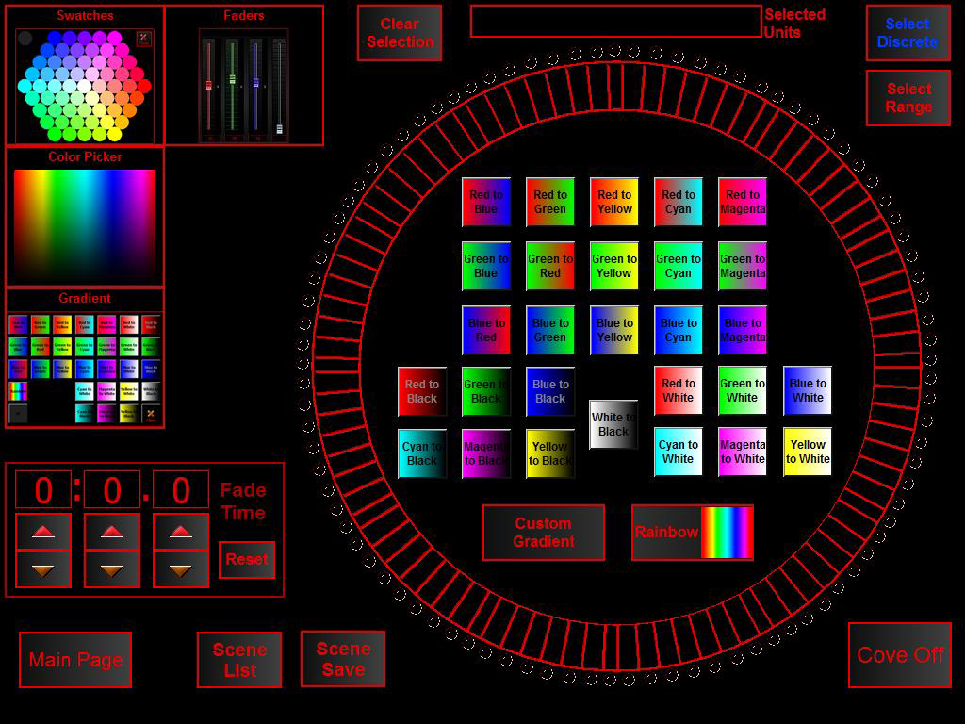
In Our Booth
New G4 LED Light Control GU

Slide 7
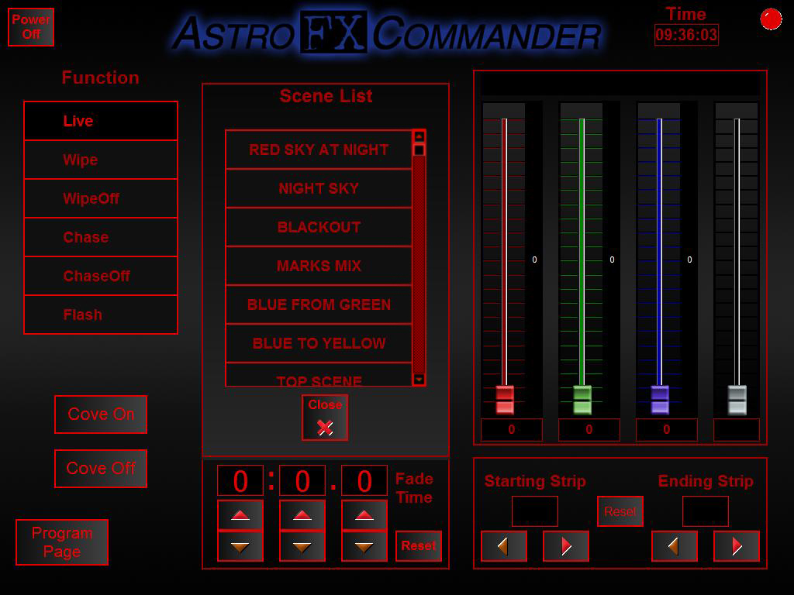
In Our Booth
New G4 LED Light Control GUI

Slide 8
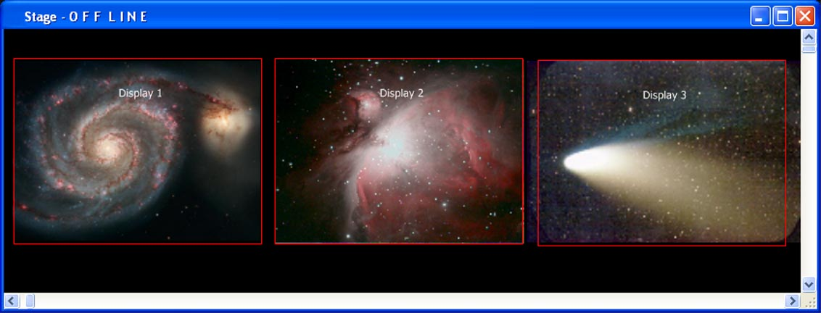
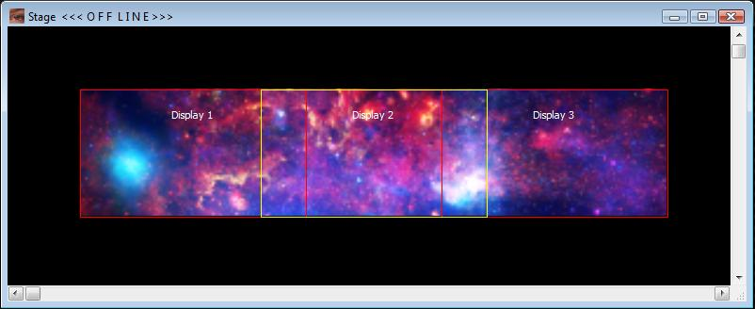
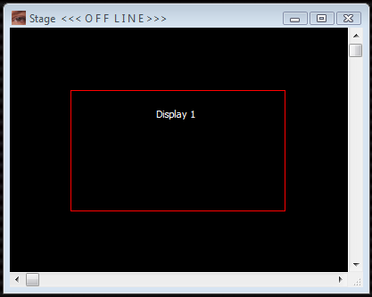
In Our Booth
AstroFXMedia Manager-Panoramics!!!!
Real time warping/geometry corrections…
3-Screen
1920 x 1200
Per Screen
Edge Blended Pan
5184 x 1200
1920 x 1200
Single Screen

Slide 9
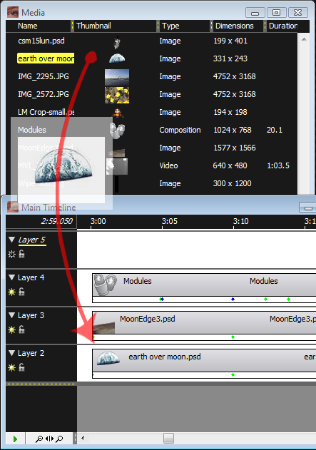
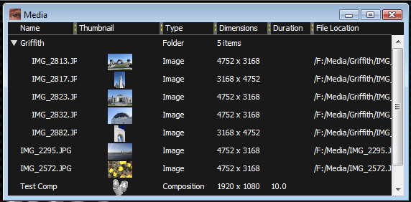
In Our Booth
AstroFXMedia Manager-Drag & Drop- No Rendering

Slide 10
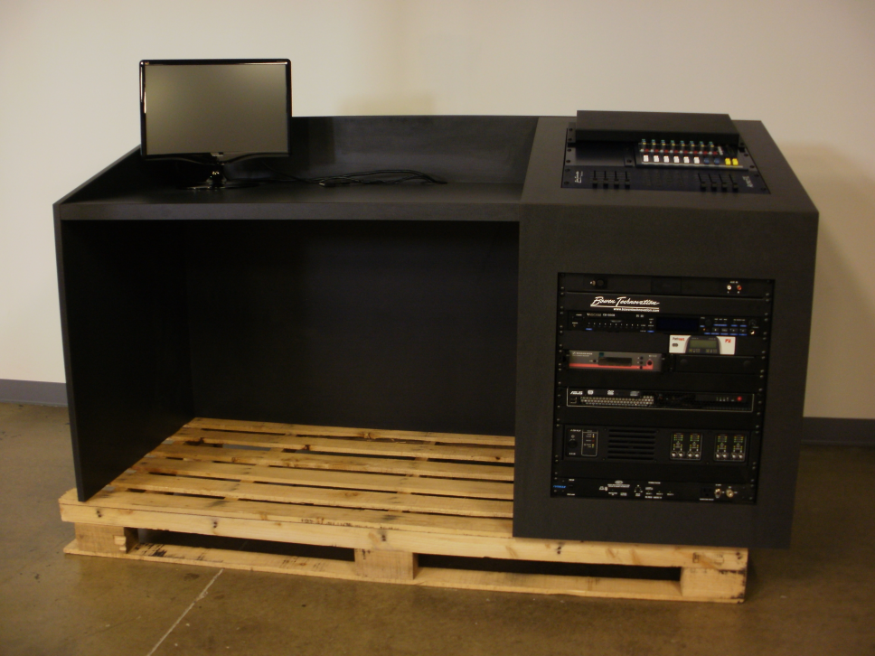
In Our Booth
New Custom Consoles
Flat smooth surfaces for manuals, scripts and writing.
Slanted mixer rack that is at the correct angle for operation.
3” grommets for wireways.
Straight front rack for equipment.
Modesty panel on all sides.
Desktop has side and back shroud to hide wiring, block light , prevents pushing items off sides/front.
Locking rear access door.
Attractive laminate finish that can be custom color matched upon request.
Larger custom consoles still available.
Why did we design these??

Slide 11
“Bowen Technovation Celebrates 25th Year…
Thanks!!!!!”

