Slide 1
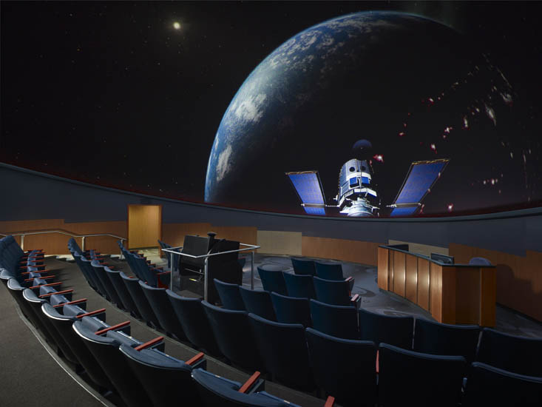
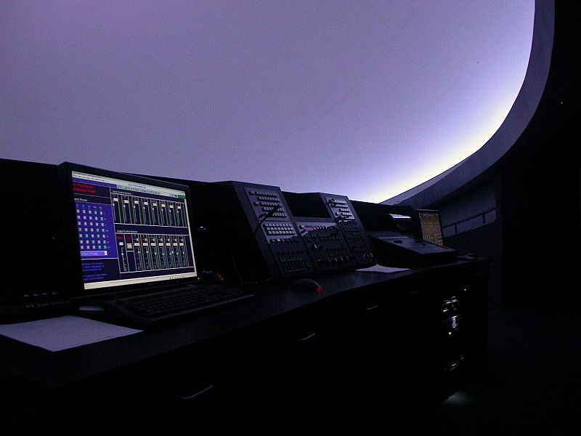
“Modern Instructional/Event Presentation Technologies for Immersive/Planetarium Theaters”
A Workshop for IPS 2012
By: Mark Trotter, Jeff Bowen
© ℗ 2012 Bowen Technovation, USA
Abstract: The modern design for a domed theater should include extensive audio-video-control capabilities for instruction, special events, and other multimedia uses. This package is one of the most overlooked parts of theater upgrade or new construction design.

Slide 2
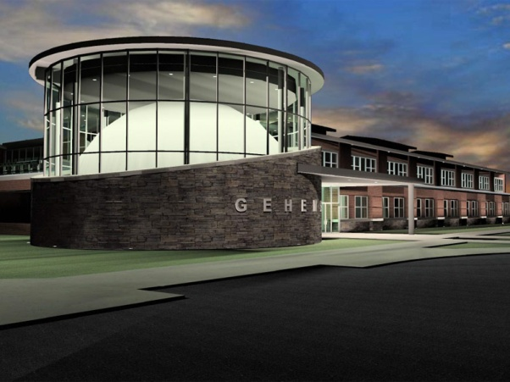
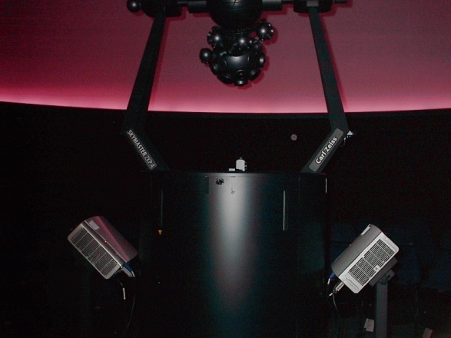
“Modern Instructional/Event Presentation Technologies for Immersive/Planetarium Theaters”
Why add such capabilities:
To all-dome video:
HDCP Compliancy!!!!
Brighter lumens per square foot.
Lose image and text legibility using all dome warping/blends.
Ease of use. Don’t turn on all-dome system.
Most do not provide hi-res external inputs
Wear and tear on projectors
Wear on matched lamps.
Fallback presentation system.
To optical projectors:
To add BluRay videos, PowerPoint, NASA select, educational programming.
To extract 5.1 surround sound from these.
To add compatibility with new digital computer outputs.
Equipment stays put and is ready for use.

Slide 3
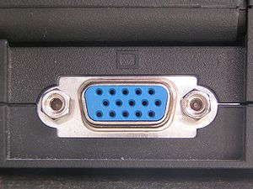
“Modern Instructional/Event Presentation Technologies for Immersive/Planetarium Theaters”
Special Considerations
VGA Obsoletion
Intel and AMD have come to an agreement to
phase out computer VGA connections beginning in 2013 and expect the technology to be off all their product lines by 2015. It will be replaced by HDMI and DisplayPort.

Slide 4
“Modern Instructional/Event Presentation Technologies for Immersive/Planetarium Theaters”
Special Considerations
Analog Sunset
All BlueRay players have utilities burned into their chipset that will automatically turn off (or downscale to super low res) the component, composite, VGA and S-video outputs on December 31, 2013. This is a Federal law that all manufacturers must adhere to. That means they will only output HDMI or another digital format.

Slide 5
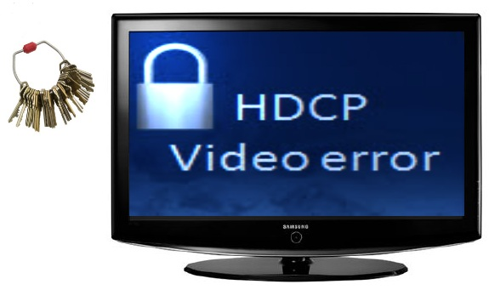
“Modern Instructional/Event Presentation Technologies for Immersive/Planetarium Theaters”
Special Considerations
High-bandwidth Digital Content Protection (HDCP ) Compliancy
Commonly though incorrectly referred to as High-Definition Copyright Protection, is a form of digital copy protection developed to prevent copying of digital audio and video content as it travels across connections.
Digital Rights Management (DRM)
Digital rights management (DRM) is a class of access control technologies that are used by hardware manufacturers, publishers, copyright holders and individuals with the intent to limit the use of digital content and devices.
Extended Display Identification Data (EDID)
Provided by a digital monitor or projector to describe its capabilities to a video source. It is what enables a modern computer, HDTV or Bluray to know what kinds of monitors are connected to it

Slide 6
Why not use your all-dome system for nuts & bolts instruction?
Lower resolution: 25 times the resolution is typical. See next slide
2. Wear and tear on expensive projectors and lamps.
HDCP , DRM and EDID Compliancy
Analog Sunset

Slide 7
Why not use your all-dome system for nuts & bolts instruction
1. Resolution: Pixels on the Dome 10’ wide image
All-dome HD Projector = 0.1M pixels on a 12’ wide image in 40 foot dome
= 1.1 K pixels per ft²
Dedicated HD Projector = 2.3M pixels on a 12’ wide image in 40 foot dome
= 25.5K pixels per ft²
20-25x resolution plus impact of light level
1920 x 1200 =2,304,000 pixels per projector
1,450,000 pixels visible per projector on dome for all-dome system
40 x 40 x 3.14/2 = 2512 ft² dome surface area or 1256 per ½ dome
1154 pixels per ft² pixels with all-dome projector
12’ w x 7.5’h image = 90 ft² dome = 2.3M pixels or 25.5K pixels per ft² dome with one dedicated projector.
12’ w x 7.5’h image = 90 ft² dome = 0.10M or 1.1K pixels per ft² dome with all dome projector
20-25 x resolution plus impact of light level

Slide 8
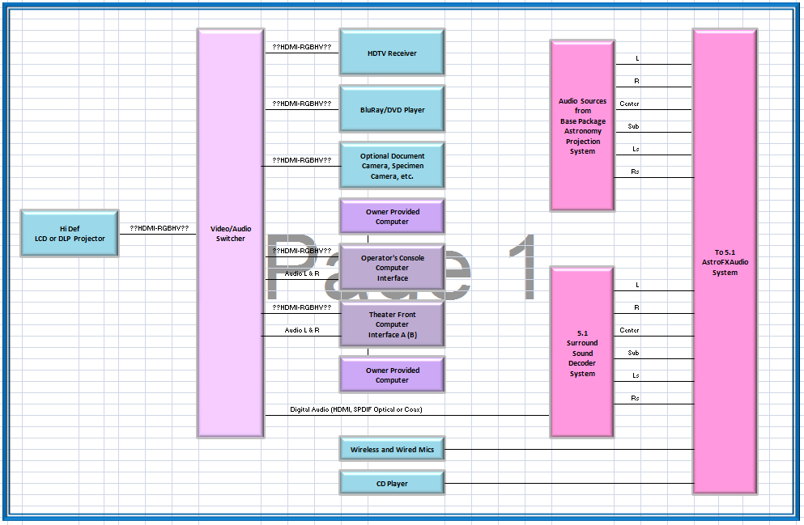
Basic Signal Path

Slide 9
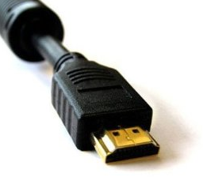
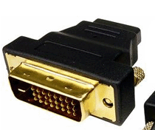
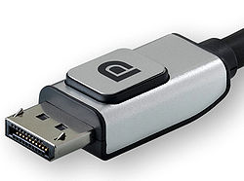
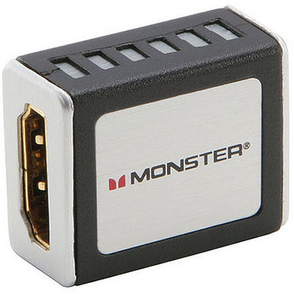
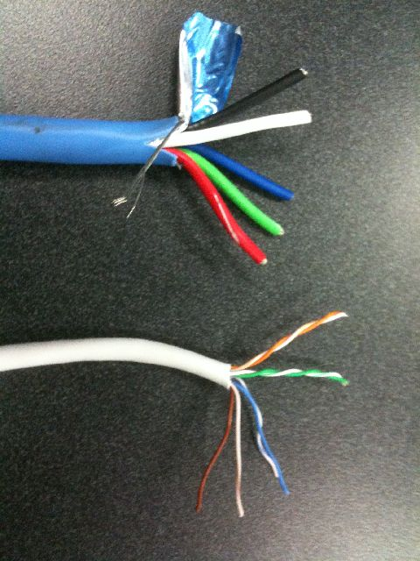
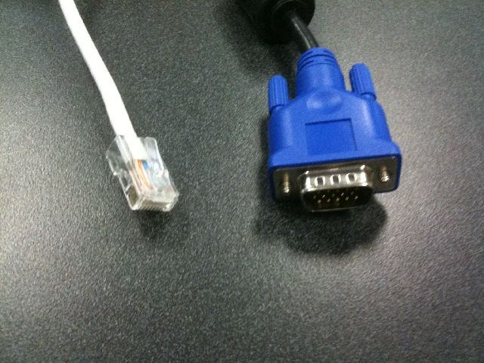
Future of Obsoleting RGBHV (VGA) and Futureproofing Video
RGBHV (VGA)
DVI
HDMI -M
DisplayPort
HDMI -F

Slide 10
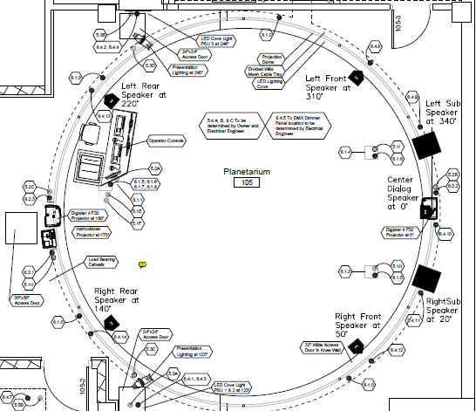
Where to locate computer and video inputs.
Computer/video/audio connection in floorbox under podium
Computer/video/audio connection in floorbox under podium
Computer/video/audio connection in pop up box at console.

Slide 11
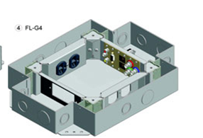
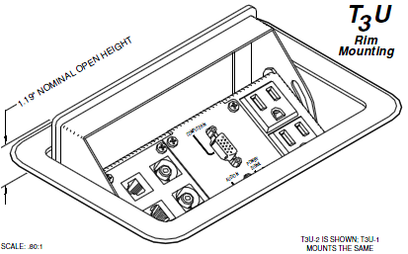
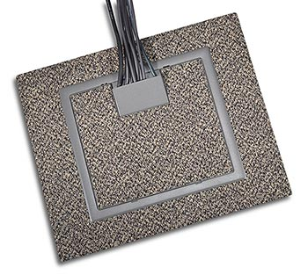
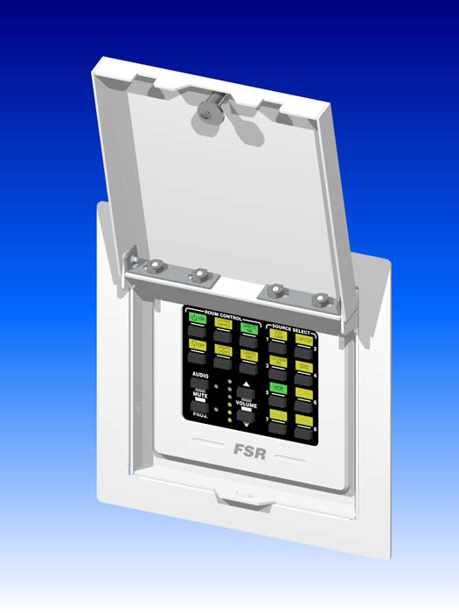
Where to locate computer and video inputs.
Floor Box
Console Pop-Up
Wall Box

Slide 12
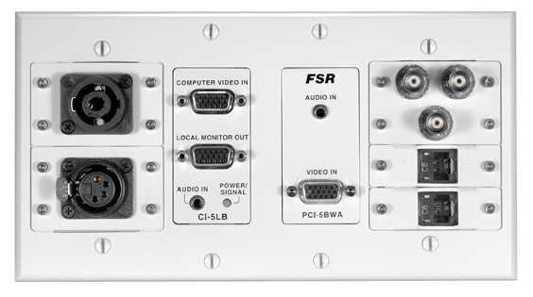
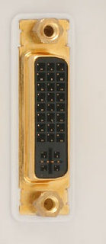
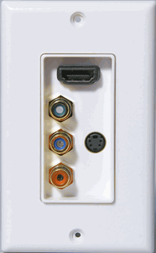
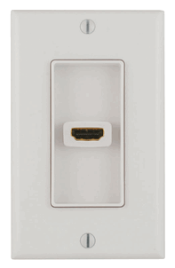
Connections
No DVI?
Why?

Slide 13
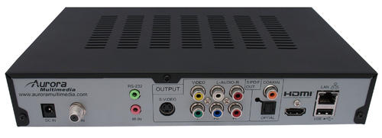
BluRay and HDTV tuners.
SPDIF digital audio out. Coax/toslink optical.
HDMI Out
Serial / Ethernet Control

Slide 14
Distance Limitations
6’
6’
30’
15m
30’
Digital deterioration due to distance
Corrected digital signal

Slide 15
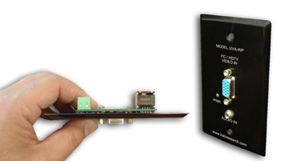
Distance Limitations: UTP-CAT5/6 Extenders (Unshielded Twisted Pair)
Extender CAT5
RGBHV (VGA)

Slide 16
Routing and Legacy RGBHV
4x1
HDMI. Audio???
RGBHV to HDMI Converter w Audio
Switcher/Scaler
HDMI, RGBHV
CV, YC (S). Audio???
4x1
HDMI w 7.1 Audio

Slide 17
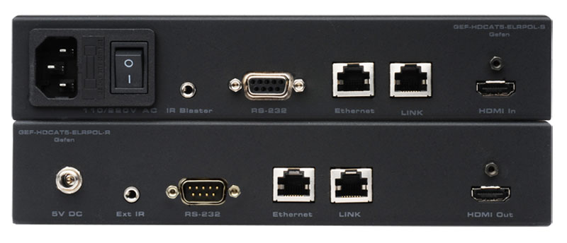
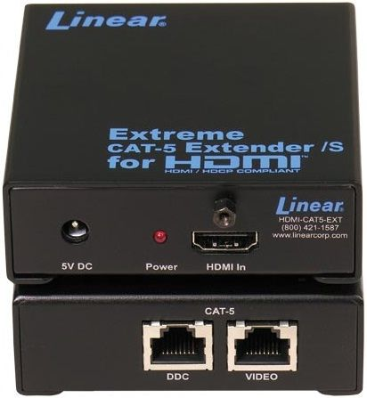
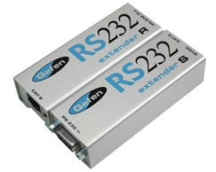
Distance Limitations: Extenders
Uses Single or 2x Cat 5/6
Various units available for
Audio only
Video only
HDMI w audio
RGBHV w audio
Above with serial 232
Must be EDID and HDCP capable

Slide 18
Distance Limitations: HDBaseT
Uses Single Cat 5/6 for 5Play™ feature set…
Full, uncompressed HD video to 4K and 3D
Audio
Ethernet
Power (100W)
And control (232, IR, other)
….over a single 100m cable.
EDID and HDCP capable

Slide 19
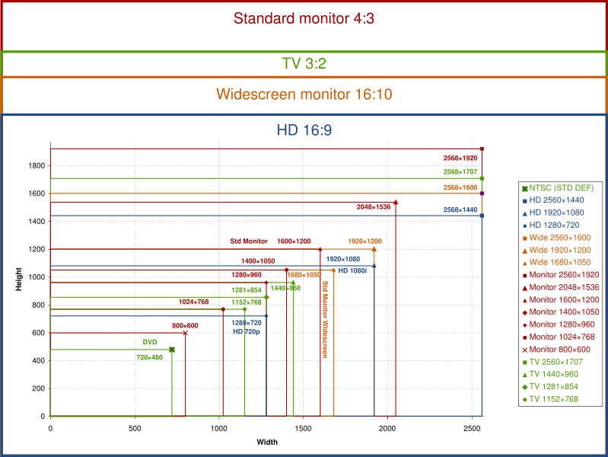
Projection Resolutions
4:3 Aspect Ratio
1440 x 1050
1.5M Pixels
16:9 Aspect Ratio
1920 x 1080
2.1M Pixels

Slide 20
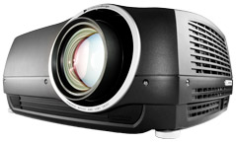
Projection
1-Chip DLP Advantages
No organic filters
Smoother video
Pixels less visible
More “filmlike” on DVD and Bluray
Generate "blacker" blacks
Higher contrast
1-Chip DLP Dis-advantages
Rainbow effect bothers some due to color wheel
More moving parts (color wheel)
Color wheel sometimes produces soft whine
LED Advantages
No color wheel = No "rainbow effect"
Slightly quieter = No color wheel
Terrific color
Excellent contrast
No lamps!!!!
Lower heat.
LED Dis-advantages
Cost
Brightness at this time… 700-1100 ANSI
LCD Advantages
No color wheel = No "rainbow effect"
Slightly quieter = No color wheel
LCD Dis-advantages
More visible pixels
Some screen door effect on certain video images
Poorer contrast
Blacks come out lighter gray than DLP projectors

Slide 21
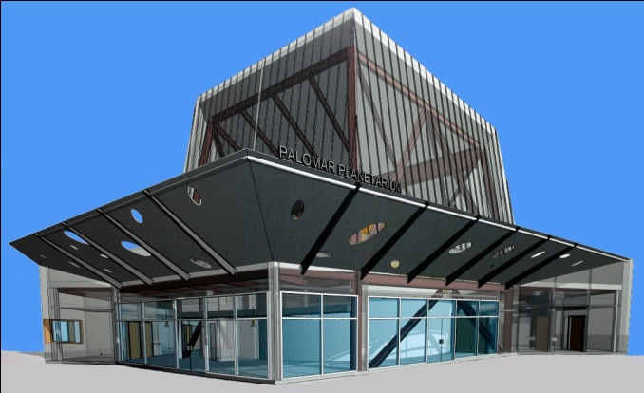
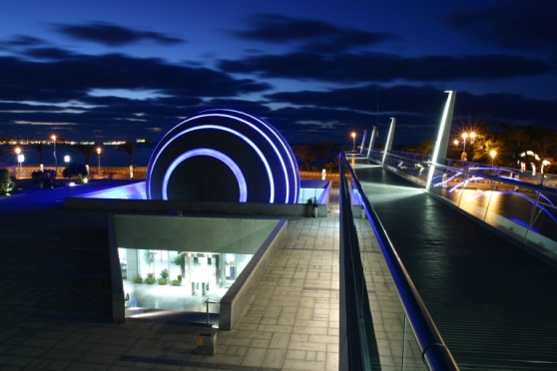
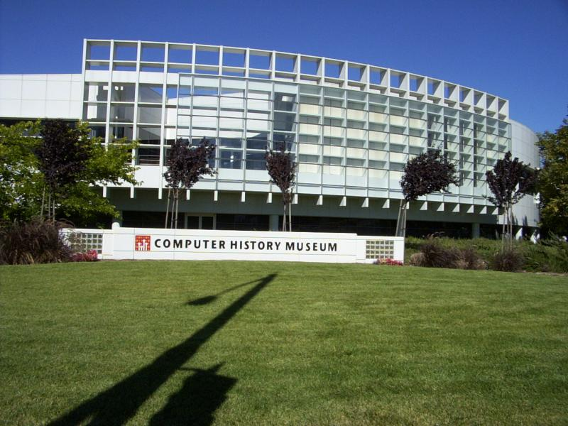
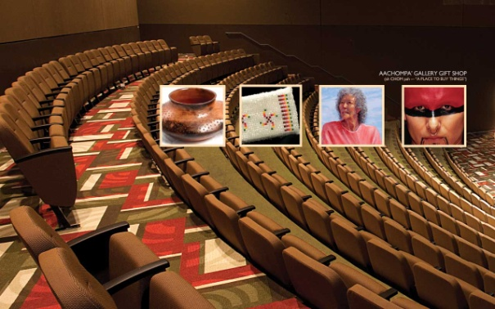
“Modern Instructional/Event Presentation Technologies for Immersive/Planetarium Theaters”
A Workshop for IPS 2012
By: Mark Trotter, Jeff Bowen
© ℗ 2012 Bowen Technovation, USA

